Slide 1
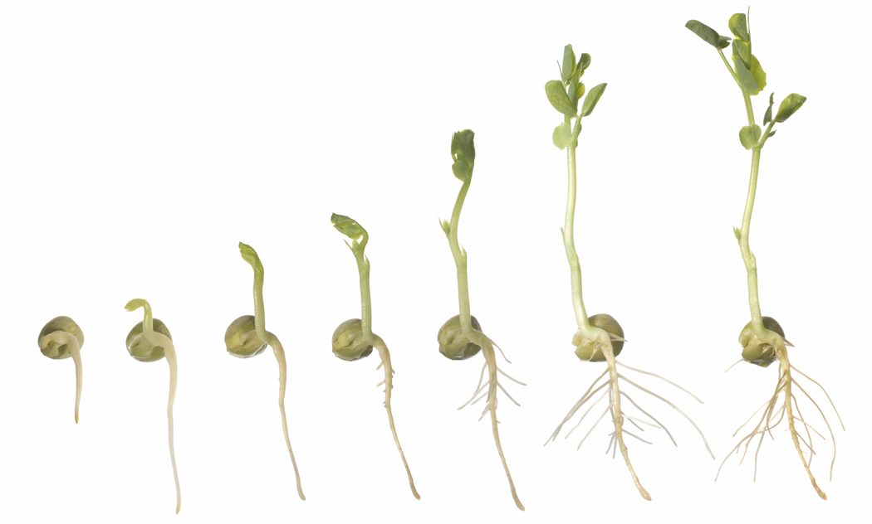
What is Student Growth Percentile (SGP)?
Compares a student’s growth to students who started with about the same score
Students are ranked in percentiles depending on how much they have grown
Scale ranges from 1 to 99
Notes:
Talking Points
Ask participants if they’ve heard of the Student Growth Percentile. SGP is a widely accepted growth measure, commonly used in many states, and now reported in the STAR assessments.
Define Student Growth Percentile: Normative growth measure that compares a student’s growth to students who started with about the same score nationwide.
It is on a scale from 1 to 99.

Slide 2
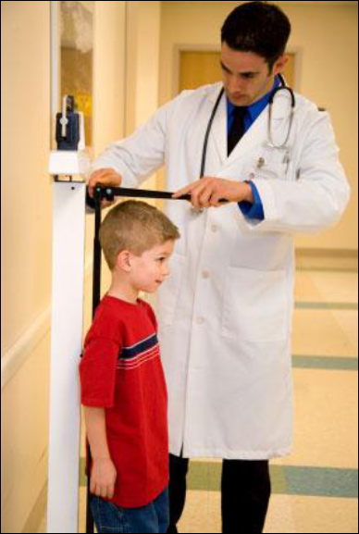
SGP is a measure of growth
A doctor uses a chart to tell you how well your child is growing in weight or height in relation to his or her peers.
SGP in STAR tells you how well your student is growing in relation to his or her peers.
Notes:
Talking points
The approach can be compared to the growth percentile you see at the doctor’s office.
The doctor measures and weighs the child and uses a chart to tell how well your child is growing in relation to his or her peers.

Slide 3
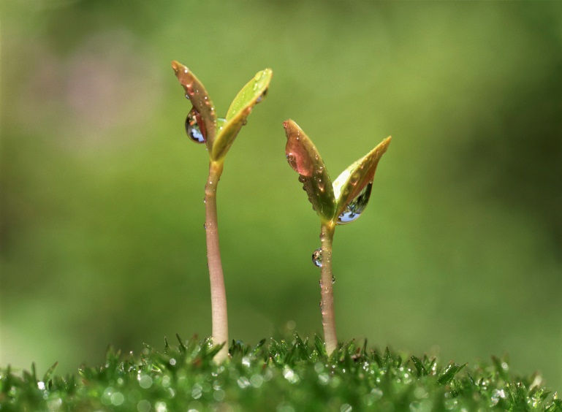
The difference between PR and SGP
Percentile Rank (PR)
how high a student scored
Student Growth Percentile (SGP)
how much a student grew
Scoring higher
Growing faster
Notes:
Talking points:
National percentile ranks and student growth percentiles sound similar but measure different things
A PR score tells how high students scored compared with other students at their grade level. It can tell you if students have “cleared the bar”(reached the benchmark).
A SGP score tells how much students have grown compared to other students like them. It can tell you how a student is moving toward (or past) the bar.
A simple way to think about it: PR is about scoring higher, SGP is about growing faster
Additional information
Teachers familiar with the growth model in the Goal Setting Wizard may confuse the two scores. The growth model used in the Goal Setting Wizard provides weekly growth rates useful for shorter or more customized time periods. Student Growth Percentile compares student scores over longer periods, like a semester or a full school year.

Slide 4
A student example of growth
Krista, Grade 7
Fall STAR Math = 651 SS
Spring STAR Math = 741 SS
Increase of 90 SS
How do we decide if that is good, bad, or average?
Compare her growth to the growth of her academic peers
Notes:
Talking Points (click for each to appear):
Click through the first four bullets on the slide to tell about Krista. She’s a seventh grader with a fall STAR Math scaled score of 651 and a spring STAR Math score of 741. That’s an increase of 90 scaled score over the course of the school year.
How do we decide if this is good, bad, or average?
This is not an easy question to answer because students at different performance levels in different grades grow at different rates.
For example, a high-achieving 3rd grader grows at a different rate than a low-achieving 3rd grader.
A high achieving 3rd grader grows at a different rate than a high-achieving 2nd grader.
Answer: compare Krista’s growth to that of her academic peers

Slide 5
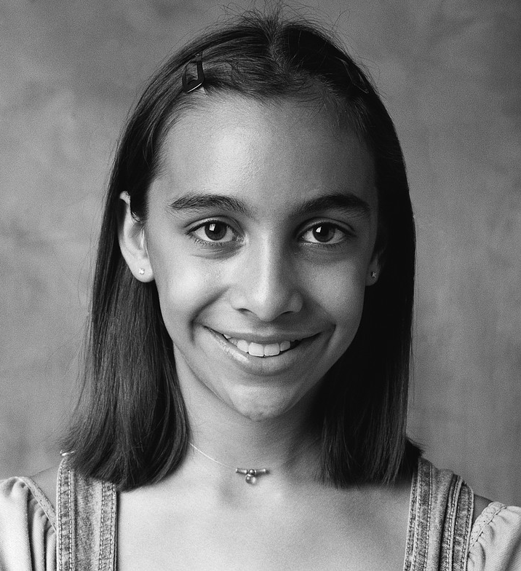
Academic Peers have the Same Grade Level and Starting Score
651
651
651
651
651
651
651
651
651
651
651
651
651
651
651
651
651
651
651
651
651
651
651
651
651
651
651
651
651
651
651
651
651
Notes:
Talking Points:
Krista’s academic peers are students at the same grade level with the same starting scaled score.
Data from the millions of STAR tests given every year is used to calculate growth norms.
In this case we’re going to look at students who scored like Krista; 7th graders who scored 651 SS in the fall.
Then we’re going to look at how these students scored in the spring.

Slide 6
How Krista’s Growth Compares to her Academic Peers
Fall: 651 SS
Krista grew as much or more than 65% of her academic peers.
65 SGP
651
Spring Scores lower than 741
Spring Scores higher than 741
651
651
651
651
651
651
651
651
651
651
651
651
651
651
651
651
651
651
651
651
651
Spring: 741 SS
741
Notes:
Talking Points (click for each):
Krista’s spring score was 741 SS.
Some of Krista’s academic peers scored higher in the spring, meaning they showed more growth than Krista.
Some of Krista’s academic peers scored lower. They showed less growth than Krista.
After looking at all the data, Krista grew more than 65% of the students who started like her.
That means her SGP is 65.
Additional information:
What is typical growth, or what is a “normal” SGP? Renaissance Learning does not provide benchmarks for typical growth, but for guidance look to the states that have adopted SGP and have identified ranges of scores to represent typical growth. For instance the Colorado and Indiana Departments of Education consider a range of 35-65 SGP to represent typical growth for individual students.

Slide 7
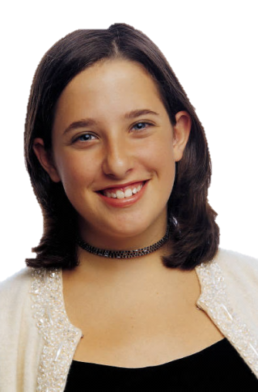
How can we discuss growth data?
Tyler Grade 6
Above Benchmark
Fall | 144 | 50th Percentile
Spring | 167 | 50th Percentile
Change | +23 | 30 SGP
Fall | 97 | 10th Percentile
Spring | 141 | 25th Percentile
Change | +44 | 75 SGP
Kianna Grade 6
Intervention
Notes:
Talking Points:
How can SGP help us have a conversation about student performance and growth?
Scores shown are for STAR Math
Consider Tyler: How is he doing?
Tyler is showing low growth (evidenced by his SGP), but fairly high achievement.
Does Tyler need more challenge? (He isn’t growing as fast as his academic peers.)
(click) Consider Kianna: How is she doing?
Kianna is showing high growth (see SGP), but is still performing below benchmark.
Does Kianna need a new instructional program or intervention? (She is making good growth with what she is currently doing and it seems to be working for her.)

Slide 8
Median Student Growth Percentiles for groups
 | Student | SGP
1 | Hugh | 6
2 | Eve | 12
3 | Clarence | 18
4 | Clayton | 21
5 | Jayden | 23
6 | Alejandra | 27
7 | Helen | 30
8 | Clinton | 32
9 | Kellie | 42
10 | Emilia | 47
11 | Jaquelyn | 55
12 | Lance | 61
13 | Roxie | 63
14 | Laura | 75
15 | Allyson | 81
16 | Mathew | 83
17 | Julio | 85
18 | Selena | 88
19 | Ashlee | 90
20 | Charles | 94
21 | Milton | 95
Median SGP for Mrs. Hahn’s 4th grade class
Notes:
Talking points:
SGP can also be calculated for a class, group, school, or district.
This is done by taking the median SGP. The point where 50% of students have a higher SGP and 50% have a lower SGP is the median SGP.
The median SGP can be used by administrators to compare growth between classes, grades, and schools.
This can aid in decision making about curriculum, instruction and professional development needs

