Slide 1
Level 1 Data Warehouse Primer for Principals
Timothy Johnson

Slide 2
Expectations
After this session you should be…
Familiar with the structure of the Level 1 Data Warehouse
Able to know what Reports to request
Able to get to these reports once access has been given to you
Able to know who to ask questions

Slide 3
WNYRIC Dataview Portal http://dataview.wnyric.org

Slide 4
For Level 1 Reports Select Left Top Left Button

Slide 5
Use Log-on acquired from your DDC

Slide 6
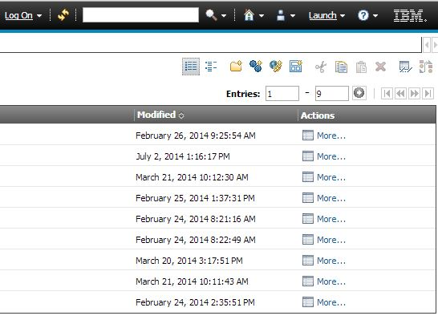
Here is the opening page

Slide 7
2nd Folder
Common Data Views – Instructional Reports (ELA & Math 3-8)

Slide 8
Common Data Views – Instructional Reports (ELA & Math 3-8)

Slide 9
Individual Student Performance

Slide 10
Performance Report with Gap Analysis by District

Slide 11
Performance Report with Gap Analysis by District

Slide 12
Performance Report with Gap Analysis by District

Slide 13
Released Questions Performance Report by District

Slide 14
Constructed Response Distribution of Points Awarded by District

Slide 15
ELA & Math 3-8 p-value Report

Slide 16
Back to Opening Page – click breadcrumb – public folder

Slide 17
3rd Folder
NYSED Publicly Released Statewide Performance Data

Slide 18
NYSED Publicly Released Performance Data

Slide 19
Scatter Charts ELA and Math 3-8 Scores

Slide 20
Scatter Plots 3-8 Assessments

Slide 21
Scatter Plots School Report Cards

Slide 22
Back to Opening Page – click breadcrumb – public folder

Slide 23
4th Folder
Data Ready Reports

Slide 24
Data Ready Reports

Slide 25
Data Ready Reports
The WNYRIC Folder gives access to a report that allows districts to monitor who has access to Level 1.
The reasonableness reports are used to help administrators compare data between two years in various categories.
Counts and details gives summary numbers of students and pages showing student details.
The other reports are aptly described.

Slide 26
Back to Opening Page – click breadcrumb – public folder

Slide 27
5th Folder
Accountability: Assessment Scores, Levels, Trends and Graduation Reports

Slide 28
Accountability: Assessment Scores, Levels, Trends and Graduation Reports

Slide 29
Elementary & Middle Performance Level and Assessment Detail Reports

Slide 30
2013 AIS Eligible based on ELA and Math Cut Scores

Slide 31
2013 ELA and Math Scores with Comparable 2012 Levels for Student, by Teacher, Summaries

Slide 32
CDEP Report by District – Performance Levels by NCLB Subgroup

Slide 33
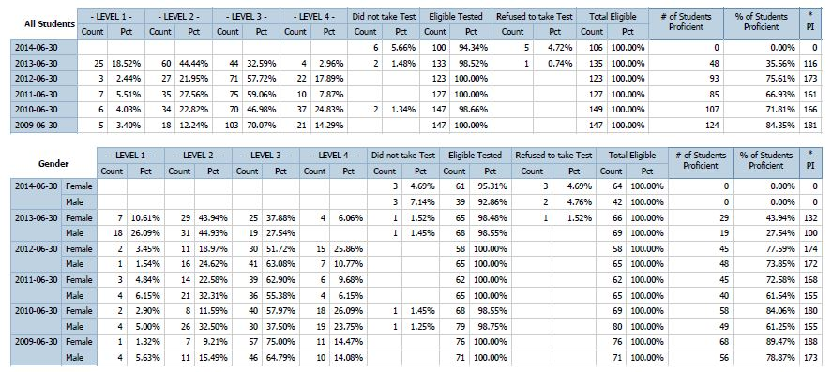
CDEP Reports
Designed for CDEP meetings but can be used in subject matter data team meetings

Slide 34
CDEP Reports

Slide 35
District Performance Level Summaries by # and %

Slide 36
District Performance Level Summary

Slide 37
Student Data and Assessment Detail Reports

Slide 38
Standard Met Reports for Assessments

Slide 39
Back to Accountability, Assessment Scores , Levels…– click breadcrumb

Slide 40
Elementary & Middle Student List Score & Rank Score Reports

Slide 41
Elementary & Middle Student List Score & Rank Score Reports
These reports have student names and numbers, so they cannot be displayed
They are aptly described

Slide 42
Back to Accountability, Assessment Scores , Levels…– click breadcrumb

Slide 43
Assessment Performance Trend Reports

Slide 44
ELA Assessment Trend Report by Level

Slide 45
ELA 3-8 Trend Summary Report by Level by Location or District

Slide 46
Standards Trend Analysis Report by Student

Slide 47
Back to Accountability, Assessment Scores , Levels…– click breadcrumb

Slide 48
Regents Performance Level and Score Reports
Same as Elementary and Middle Performance Level & Assessment Detail Reports
A few different reports
Regents Reports by NCLB Subgroup
Traditional Regents vs. Common Core Regents Scores
Regents Exam Retake
Regents Discrepancy
Regents Grade Discrepancy (Still to come)

Slide 49
Here is the Opening Page

Slide 50
Regents Performance by NCLB Subgroup – Ethnicity Example

Slide 51
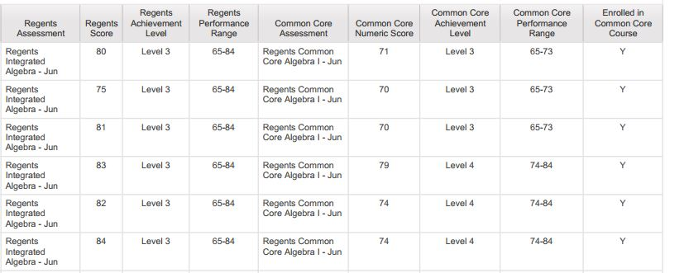
Traditional Regents vs. Common Core

Slide 52
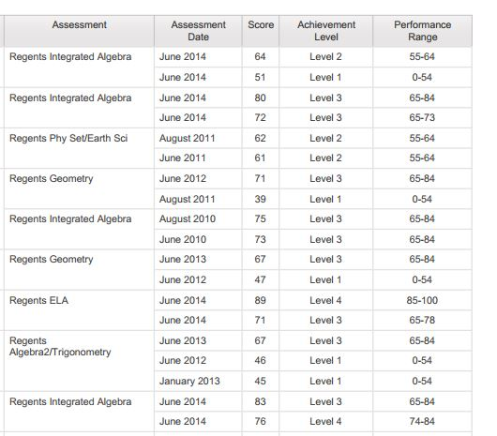
Regents Exam Retake

Slide 53
Regents Discrepancy – Reported Score vs. Scanned Score

Slide 54
Back to Accountability, Assessment Scores , Levels…– click breadcrumb

Slide 55
Grade 9 Entry Year Reports & Graduation Data Reports

Slide 56
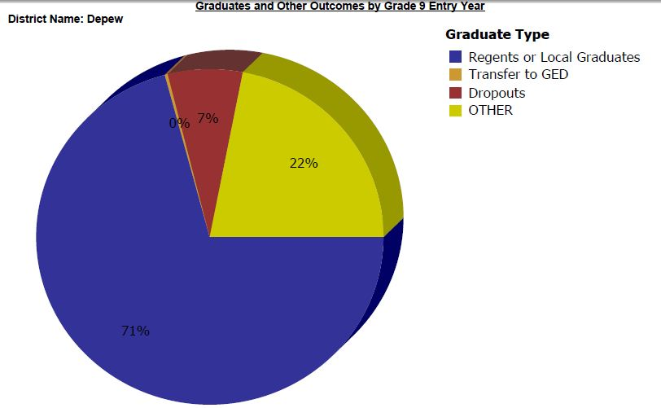
Graduates & Other Outcomes by Grade 9 Entry Year (School Year)

Slide 57
Student List – Highest Regents Score by Subject Area

Slide 58
Regents Scores by Subject Performance Summary Report

Slide 59
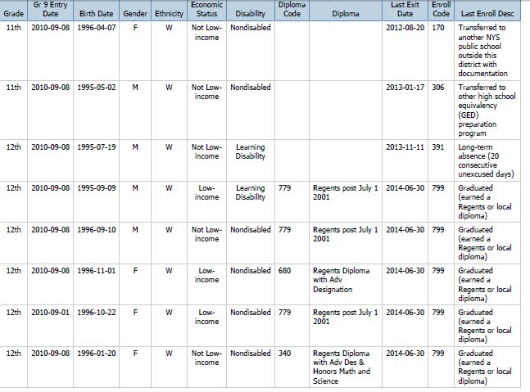
Student List by Grade 9 Entry Year

Slide 60
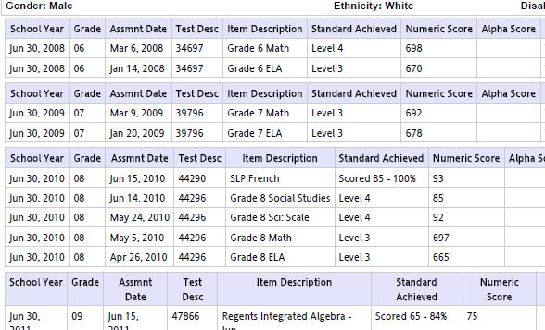
Student Assessment List by Grade 9 Entry Year

Slide 61
Student Enrollment Verification Report by Grade 9 Entry Year

Slide 62
Use breadcrumb to go back to Public Folder

Slide 63
6th Folder
Curriculum & Instructional Item Analysis Reports

Slide 64
Curriculum & Instructional Item Analysis Reports

Slide 65
Elementary ELA and Math Item Response & Analysis Reports

Slide 66
Elementary ELA and Math Item Response & Analysis Reports
Historical ELA & Math Reports House Reports used for assessments during and prior to 2012.
Current Teacher Rosters with Prior Year Test Results Reports Folder
Most of these reports were covered in the Common Data Views section.

Slide 67
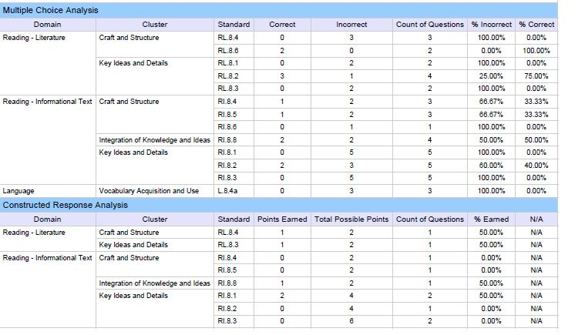
Item Response Analysis per Student (ELA & Math 3-8)

Slide 68
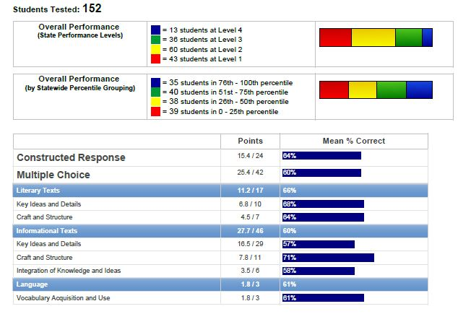
Summary Score Bar Chart Report by District

Slide 69
Elementary Sci and Soc St Item Response & Analysis Reports

Slide 70
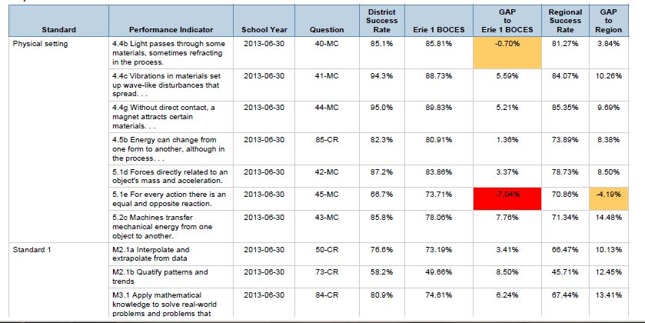
Gap Analysis by District

Slide 71
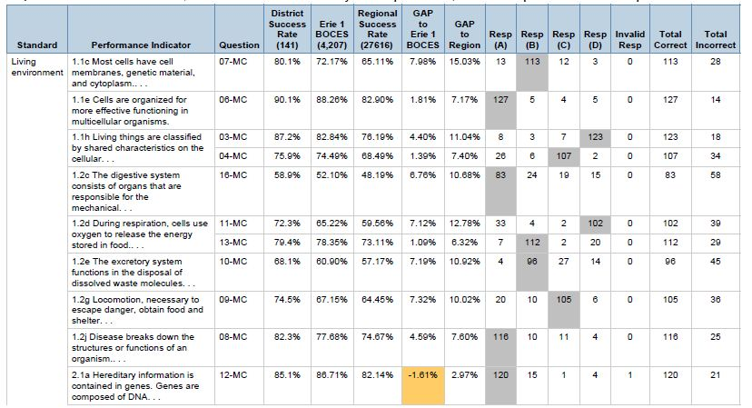
Item Difficulty and Response Gap Analysis

Slide 72
Elementary Sci and Soc St Item Response & Analysis Reports
Other items are similar to previous items
Some have student sensitive data that cannot be displayed in this workshop for security reasons.

Slide 73
Regents Item Difficulty & Response Reports

Slide 74
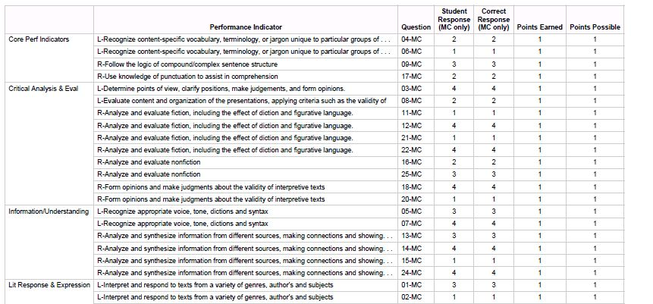
Item Responses per Student by Location & Performance Level

Slide 75
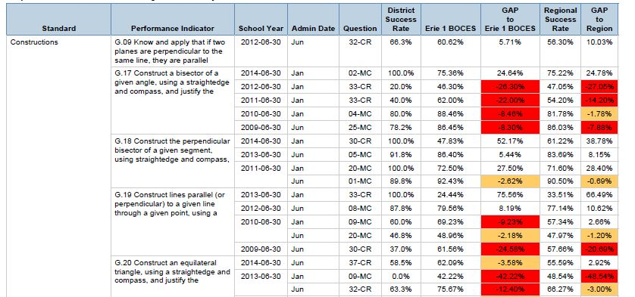
Longitudinal Gap Analysis by District

Slide 76
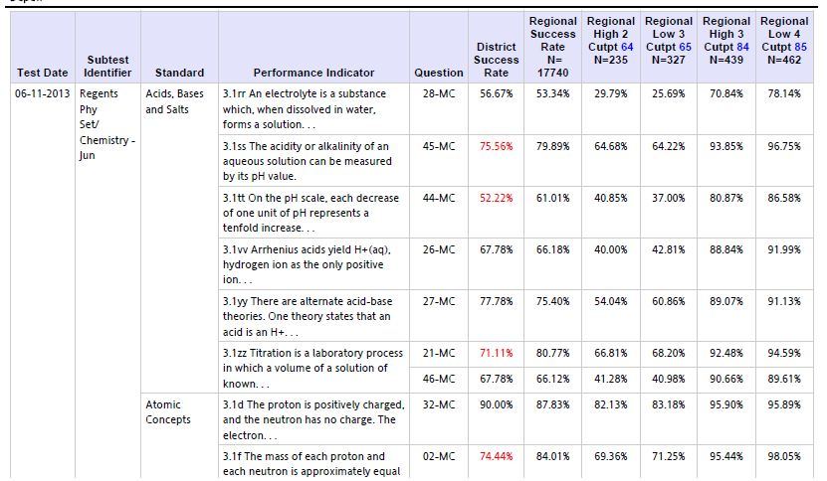
Regional Benchmarks - Cutpoints

Slide 77
Use breadcrumb to go back to Public Folder

Slide 78
7th Folder
NYSESLAT Reports

Slide 79
Contents of NYSESLAT Folder

Slide 80
Use breadcrumb to go back to Public Folder

Slide 81
8th Folder
District Reports for Data Quality

Slide 82
Contents of District Reports Folder

Slide 83
Verification Reports – Demographics, Enrollment, Program Service

Slide 84
Verification Reports – Special Education

Slide 85
Verification Reports – Student & Assessment Lists/Counts

Slide 86
Verification Reports – Staff & Course & Attendance & Final Grade

Slide 87
Excel/CSV Exports

Slide 88
Use breadcrumb to go back to Public Folder

Slide 89
9th Folder
NSC College Reporting

Slide 90
NSC College Reporting

Slide 91
Contacts
Erie 1 BOCES Data Consultant Team
David Scalzo
dscalzo@e1b.org
Elizabeth Freas
efreas@e1b.org
Timothy Johnson
tjohnson@e1b.org

