Slide 1
Erie 1 BOCES Lead Evaluator Series # 6
May 13, 2015
Inter Rater Reliability with ELLs
Data Analysis

Slide 2
This presentation is a taste..
Education for the Future Initiative
http://eff.csuchico.edu/html/home.html
Data Analysis for Continuous School Improvement – 3rd Edition
By Victoria Bernhardt

Slide 3
What would it take to get learning growth for every student, every year in your school?

Slide 4
8 things
Teachers & Administrators must honestly review and use their data – ALL their data, not just study a gap here or there.
Teachers & Administrators must truly believe that all students can learn, or learning cannot and will not happen.
There must be one vision for the school – we have to get everyone on the same page and moving forward together.
One plan to implement the school vision must be in place. We cannot implement multiple unrelated plans.
Curriculum, instructional strategies, and assessments must be aligned to student learning standards. We will only spin in circles if we do not have this alignment.
Staff need to collaborate and use student, classroom, grade level, and school level data. Teachers need to work together to determine what they need to do to ensure every student’s learning.
Staff need professional learning to work differently when the data tell them they are not getting the results they want or that they might not be getting the results they expect. (Professional learning refers to ongoing, job embedded, results-oriented learning for professional educators.)
Schools need to rethink their current structures as opposed to adding on to what is existing. (Structures include how curriculum & instruction are delivered. Add-ons are programs and interventions added to close a gap.)

Slide 5
Moving from compliance to a commitment to continuous improvement

Slide 6
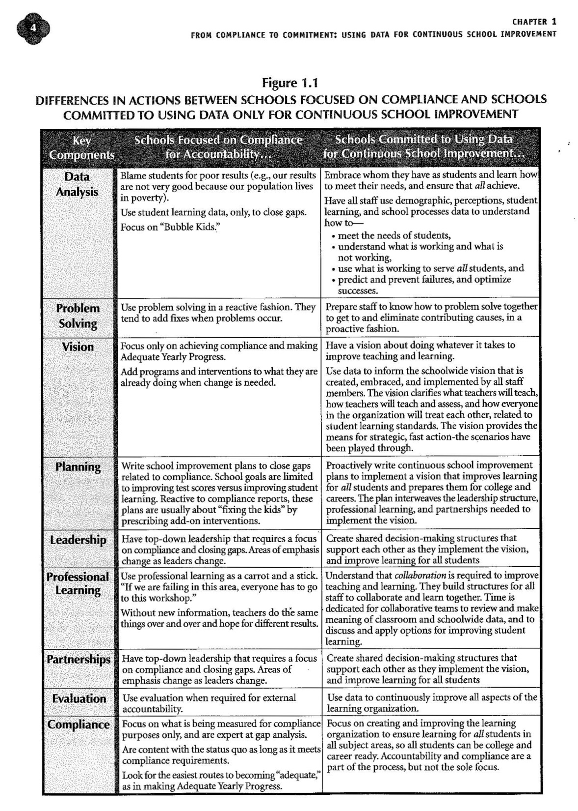

Slide 7
What is in the Book?
It’s a call to action
It’s a one year plan
The book provides a framework for action
It provides examples and tools

Slide 8
The Continuous School Improvement Framework

Slide 9
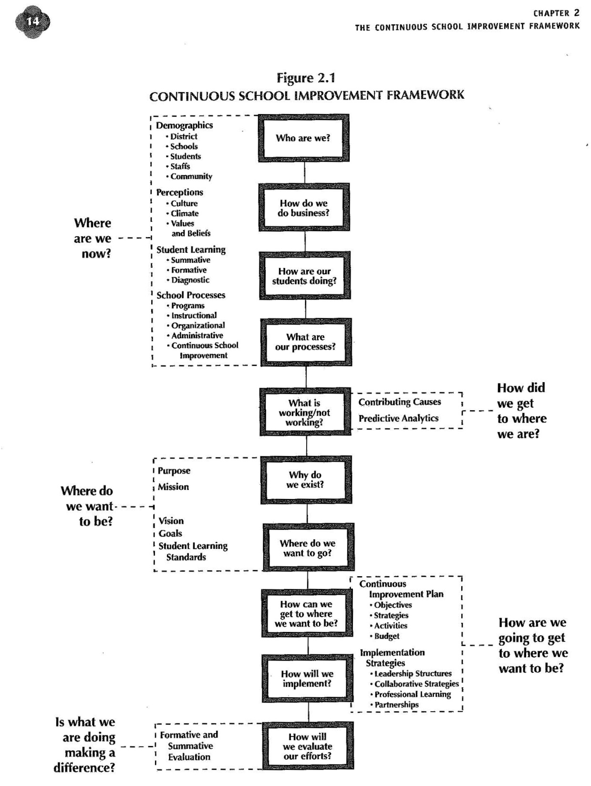

Slide 10
Multiple Measures of Data
What does using “All Data” mean?

Slide 11
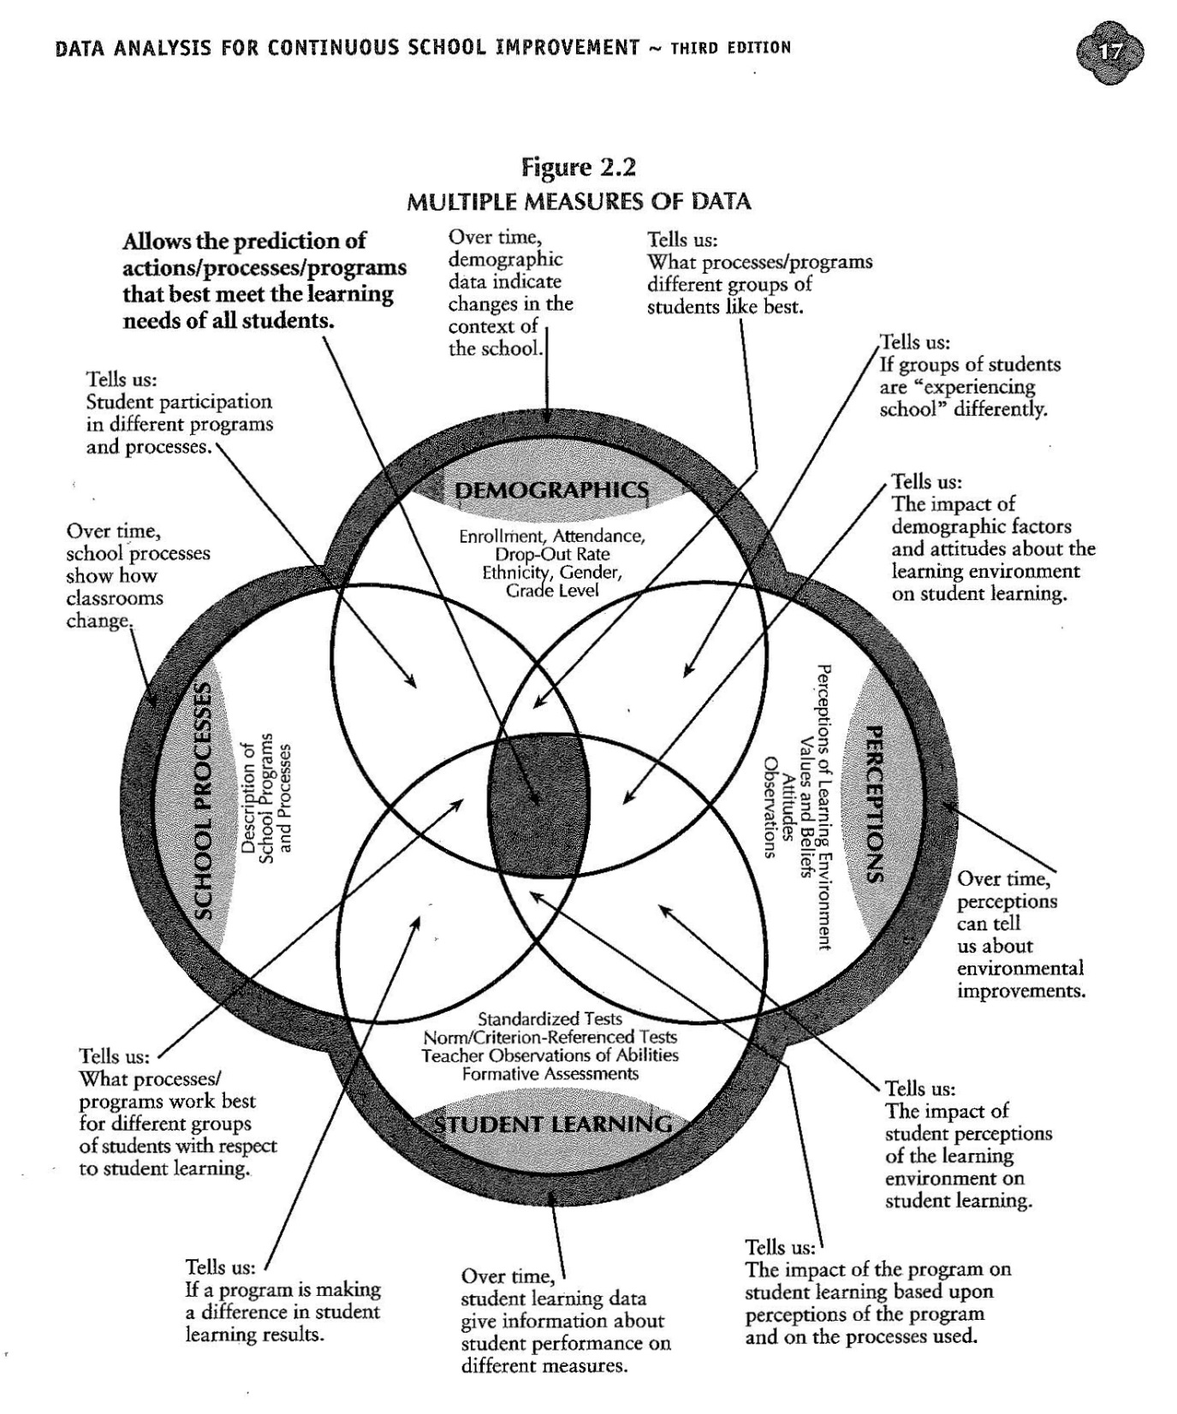

Slide 12
Continuous School Improvement Cycle

Slide 13
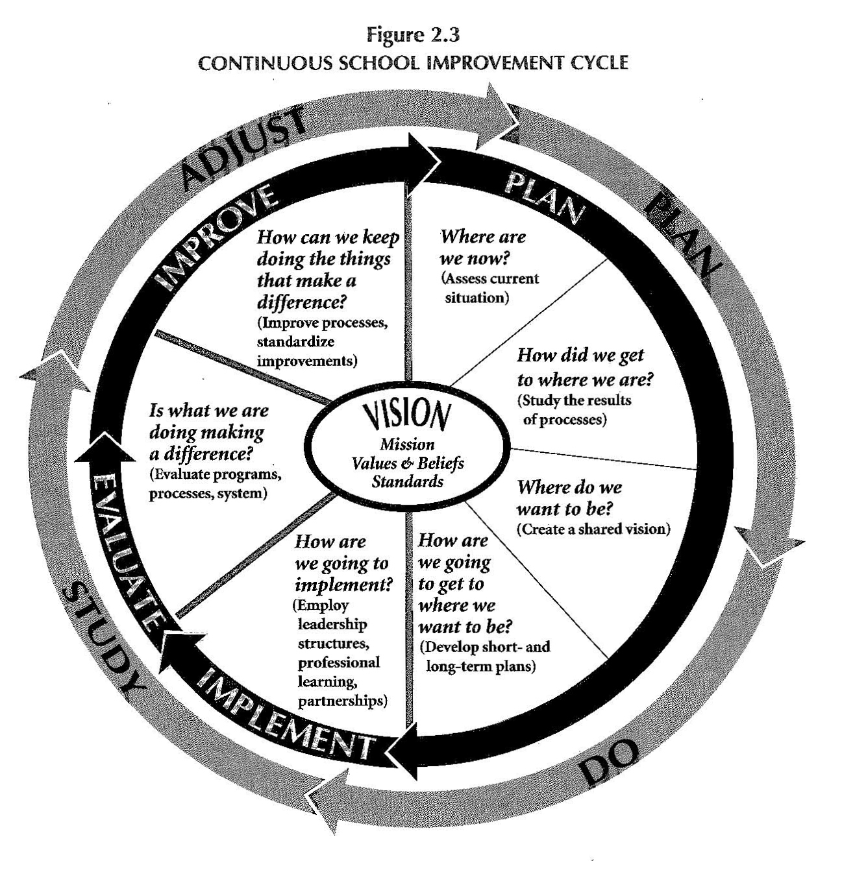

Slide 14
Continuous School Improvement Framework

Slide 16
What Most Schools Do
They skip to “How are our students doing, not realizing that they have missed the opportunity to innovate, rethink, and improve their systems.” pg. 20

Slide 17
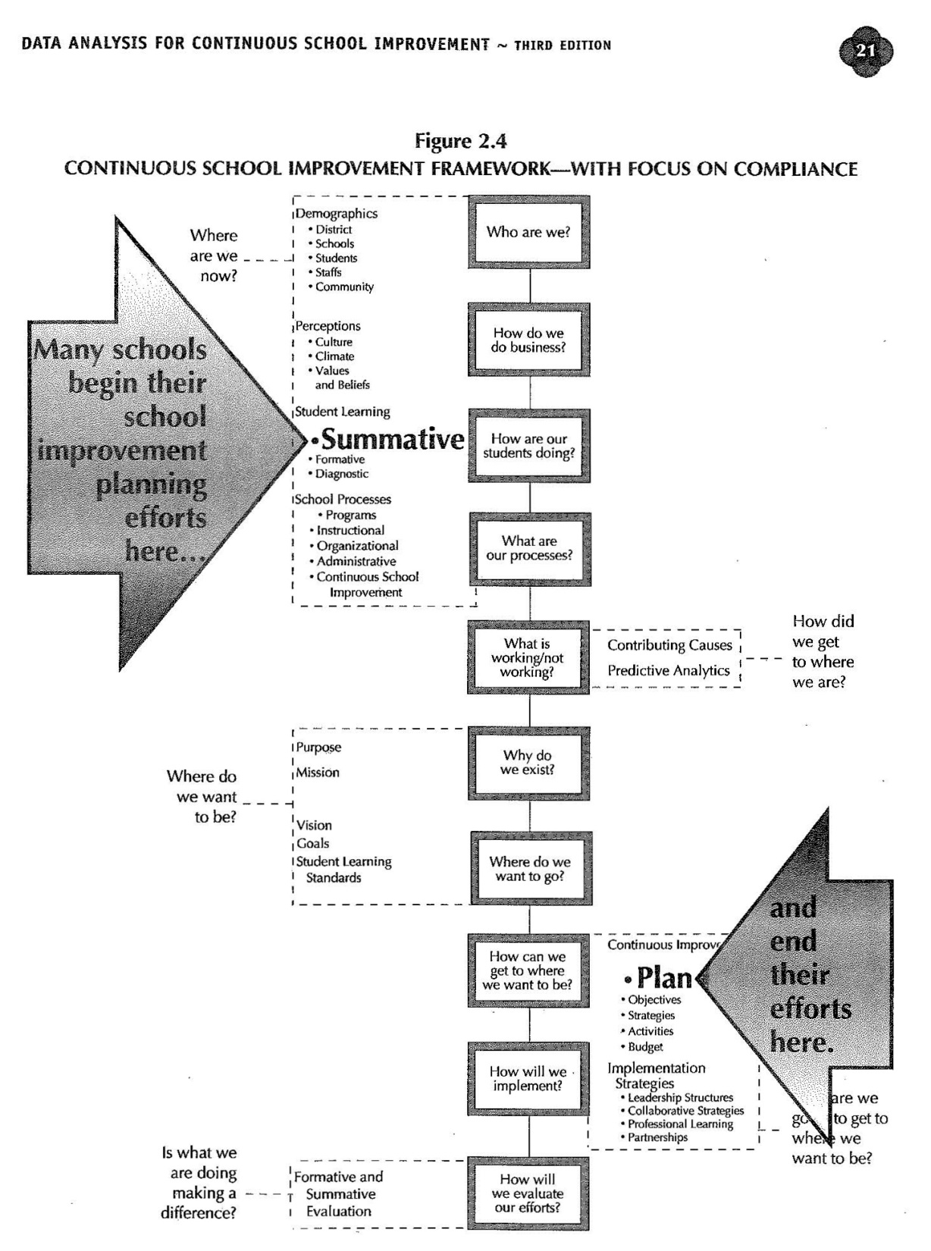

Slide 18
What Most Schools Do
They also skip the middle. What is working/not working? , Why do we exist?, and Where do we want to go?

Slide 20
What Most Schools Do
They end with Plan and miss the end of the framework as well. How will we evaluate our efforts? pg. 21

Slide 21
In order to help districts start at the right place, you can use data collection devices such as…

Slide 22
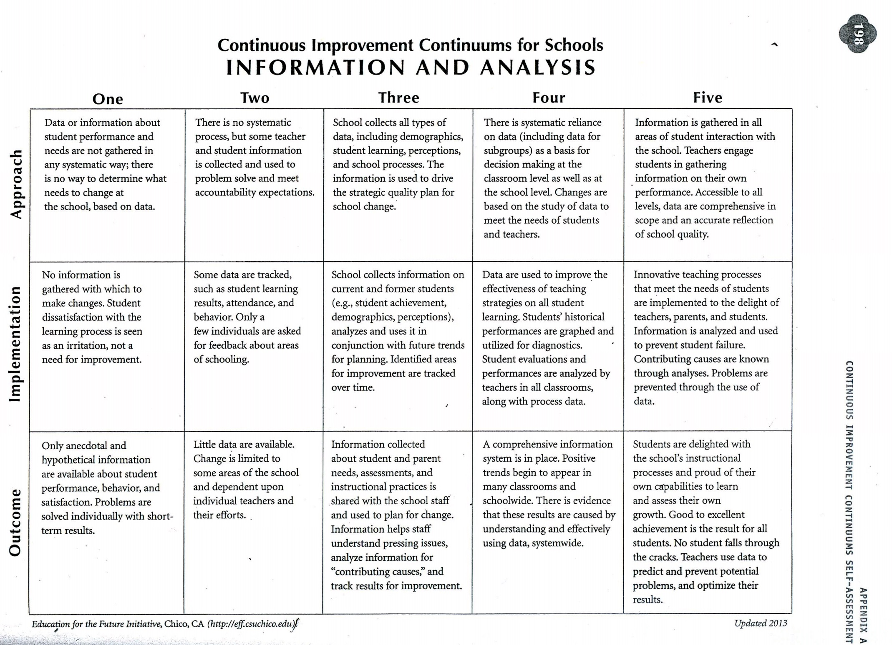

Slide 23
Have stakeholders put dots on the continuous improvement continuums self-assessments to get a handle on where the district is. Here is what it looks like…

Slide 24
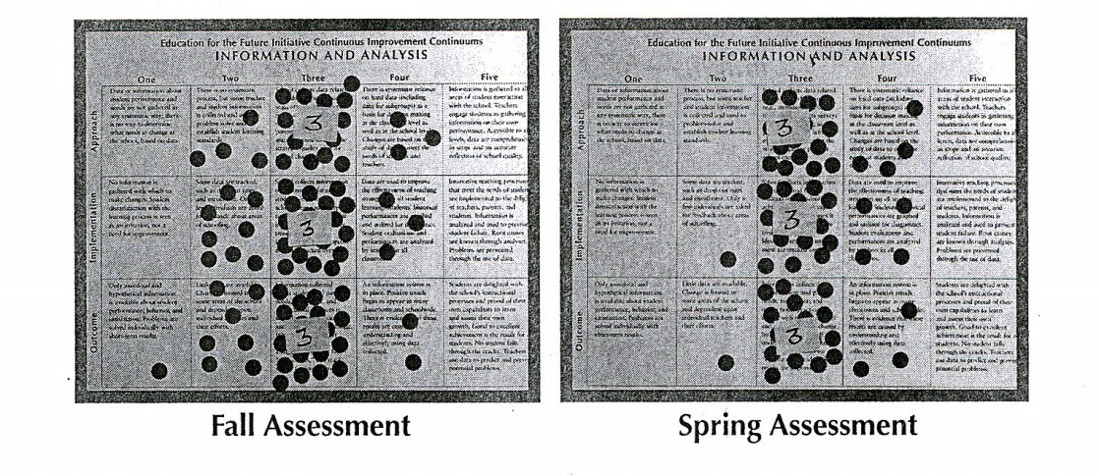

Slide 25
Comments about the tool
By using the book as a tool, districts can ensure that they are implementing continuous school improvement and not just compliance.
There are timelines in the book as well. It says if you implement the book you can move through it in one year.

Slide 26
August 18
Brad Geise from Education for the Future will be doing a day long session where he will go into detail using the Data Analysis book. He has indicated the day is setup where he presents and then does an activity around the concept.
Participants should be Administrators and Teacher leaders involved in District data work.

Slide 27
2015 – 2016 Data Follow-up
Districts will then have the ability to get support from E1B coordinators (Instructional and CSLO/Model Schools) during the school year.
Education for the Future offers monthly webinars to support districts working through the process.
We have the option to have Brad come back to follow-up if needed.

Slide 28
Education for the Future Initiative
http://eff.csuchico.edu/html/home.html

Slide 29
Flyer for August 18

Slide 30
Contact Information
Erie 1 BOCES Data Consultant
Timothy Johnson
tjohnson@e1b.org

