Slide 1
Subgroup Performance Evaluation Using NYSED Accountability Data
Elem/Middle Level Version
3-3-15
Timothy Johnson

Slide 2
Teaching You to Fish!

Slide 3
Pull the Resources
http://data.nysed.gov/
2012-2013 School Report Card
2011-2012 School Report Card
Level 2 SIRS 102
AYP Chart - http://www.p12.nysed.gov/irs/accountability/amos/

Slide 4
Pulling the Report Cards
Go to http://data.nysed.gov/

Slide 5
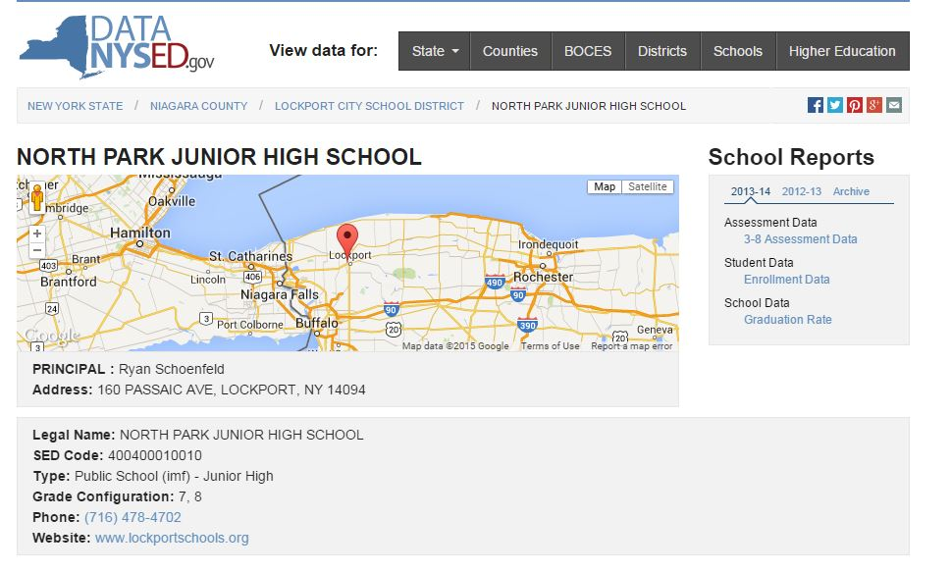
Just Pull Accountability

Slide 6
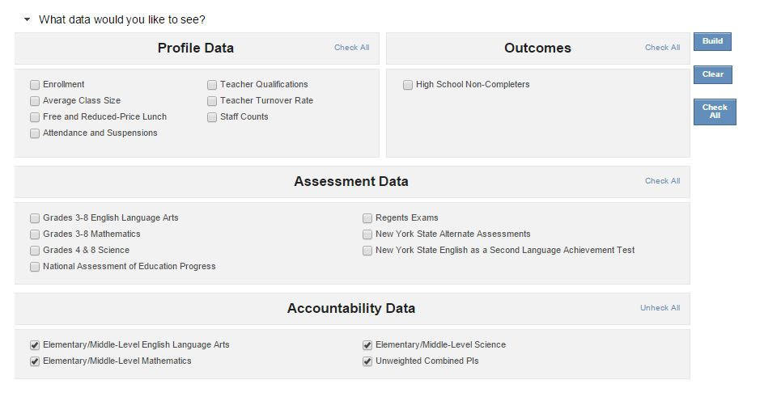
Go to School Report Card and Build It

Slide 7
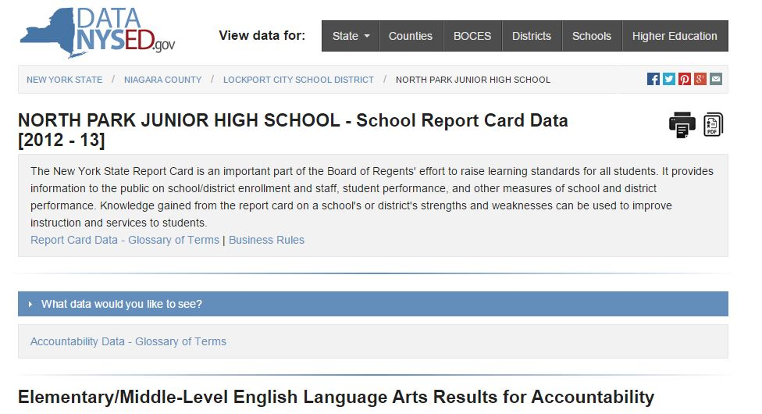
Make it a PDF

Slide 8
Keep Going
Print it - Do it again for 2011-2012
Go get the EAMO Chart
http://www.p12.nysed.gov/irs/accountability/amos/
Print it

Slide 9
Here We Go!
Locate the 2011-2012 Card
Locate the score (PI) for All Students 2nd ELA
Locate the EAMO for All Students 2nd ELA
What’s the difference?
Calculate the Gap (+ or -)
Do the same for the Subgroups (White, SWDs, Econ Disadv, etc.)
Do the same for 2nd Math
Same Routine for 2012-2013

Slide 10
Put the Data Into a Chart
All Students | PI | EAMO | Gap (+ or -)
Female
Male
American Indian/Alaska Native
Black
Hispanic
Asian or Native Hawaiian/Other Pacific Islander
White
Multiracial
Students with Disabilities
Limited English Proficient
Economically Disadvantaged

Slide 11
Extend the Activity
The EAMO chart is there for 2013-2014 (It’s even there for 2014-2015)
Level 2 has the same data
Let’s see how 2013-2014 is doing
We can already see how Secondary is doing
Pull Elem/Middle Level Accountability from Level 2 – SIRs 102

Slide 12
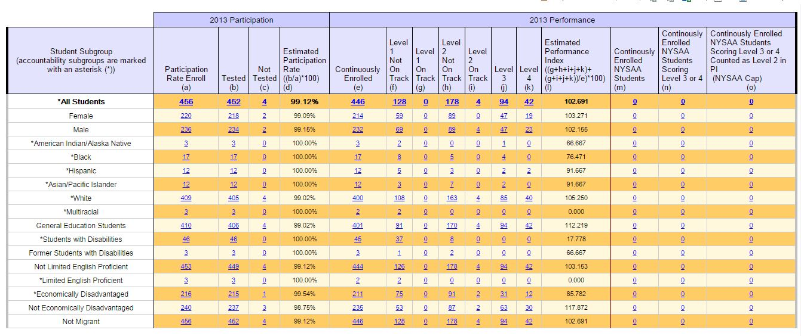
What SIRS 102 looks like

Slide 13
Here are some examples

Slide 14
Middle ELA Example District #1
2011-2012
All Students +4 Gap
White -8 Gap
SWD -9 Gap
Econ Disadv +10 Gap
2012-2013
All Students +26 Gap
White +5 Gap
SWD even
Econ Disadv +28 Gap
2013-2014
All Students +14 Gap
White -6 Gap
SWD -4 Gap
Econ Disadv +4 Gap

Slide 15
Middle Math Example District #1
2011-2012
All Students even
White -9 Gap
SWD -39 Gap
Econ Disadv even
2012-2013
All Students +25 Gap
White +8 Gap
SWD -8 Gap
Econ Disadv +29 Gap
2013-2014
All Students +38 Gap
White +23 Gap
SWD +18 Gap
Econ Disadv +30 Gap

Slide 16
Questions to Ask?
Are the Gaps Increasing or Decreasing?
Who needs to know about the trends?
What could be the causes of the trends?

Slide 17
Elementary ELA Example District #2
2011-2012
All Students +30 Gap
White +16 Gap
SWD +37 Gap
Econ Disadv +42 Gap
2012-2013
All Students +38 Gap
White +17 Gap
SWD +19 Gap
Econ Disadv +47 Gap
2013-2014
All Students +29 Gap
White +14 Gap
SWD ------------
Econ Disadv +43 Gap

Slide 18
Elementary Math Example District #2
2011-2012
All Students +22 Gap
White +14 Gap
SWD +28 Gap
Econ Disadv +34 Gap
2012-2013
All Students +54 Gap
White +37 Gap
SWD +35 Gap
Econ Disadv +63 Gap
2013-2014
All Students +46 Gap
White +32 Gap
SWD ------------
Econ Disadv +50 Gap

Slide 19
Elem/Mid ELA Example District #3
2011-2012
All Students +14 Gap
African American +9 Gap
White +18 Gap
Econ Disadv +9 Gap
2012-2013
All Students -5 Gap
African American -1 Gap
White -6 Gap
Econ Disadv +4 Gap
2013-2014
All Students -8 Gap
African American +4 Gap
White -9 Gap
Econ Disadv -1 Gap

Slide 20
Elem/Mid Math Example District #3
2011-2012
All Students +11 Gap
African American +19 Gap
White +10 Gap
Econ Disadv +13 Gap
2012-2013
All Students +4 Gap
African American +15 Gap
White even
Econ Disadv +25 Gap
2013-2014
All Students -5 Gap
African American +21 Gap
White -14 Gap
Econ Disadv +3 Gap

Slide 21
Contacts
Erie 1 BOCES Data Consultant
Timothy Johnson
tjohnson@e1b.org

