Slide 1
School Program Evaluation Using the School Report Card
Timothy Johnson

Slide 2
Pull the Resources
http://data.nysed.gov/
2012-2013 School Report Card
2011-2012 School Report Card
AYP Chart - http://www.p12.nysed.gov/irs/accountability/amos/

Slide 3
Pulling the Report Cards
Go to http://data.nysed.gov/

Slide 4
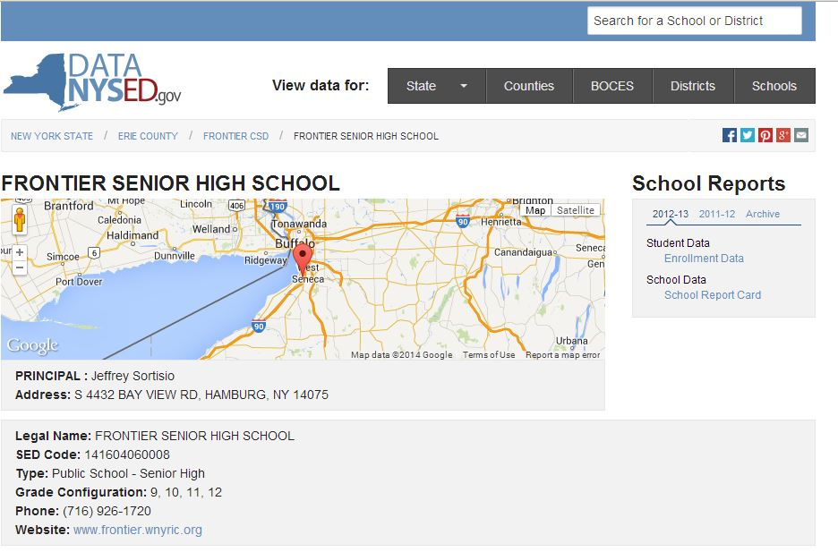
Just Pull Accountability

Slide 5
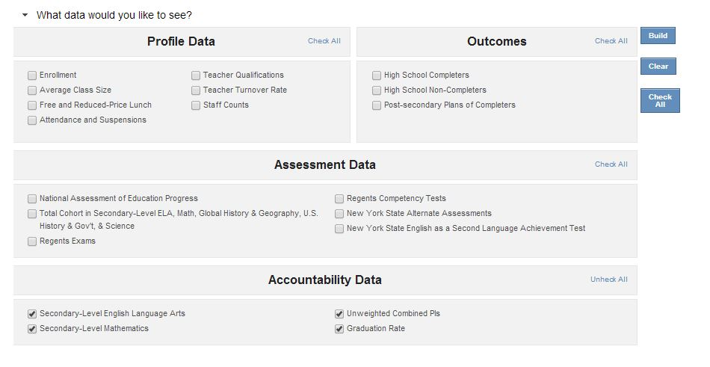
Go to School Report Card and Build It

Slide 6
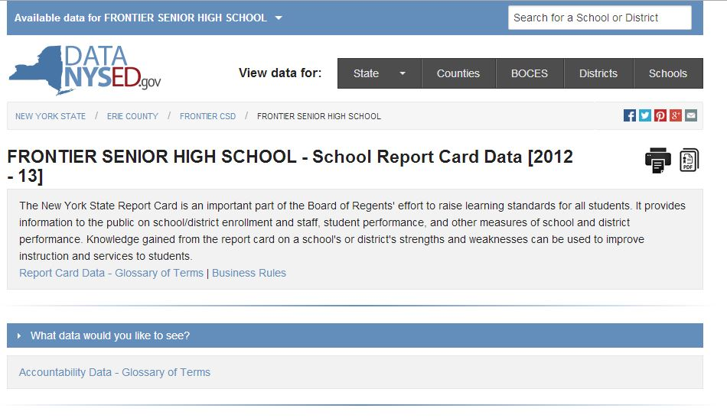
Make it a PDF

Slide 7
Keep Going
Print it - Do it again for 2011-2012
Go get the EAMO Chart
http://www.p12.nysed.gov/irs/accountability/amos/
Print it

Slide 8
Here We Go!
Locate the 2011-2012 Card
Locate the score (PI) for All Students 2nd ELA
Locate the EAMO for All Students 2nd ELA
What’s the difference?
Write it in the margin
Do the same for the Subgroups (White, SWDs, Econ Disadv, etc.)
Do the same for 2nd Math
Same Routine for 2012-2013

Slide 9
Put the Data Into a Chart
2011-2012
All Students Gap
White Gap
SWDs Gap
LEPs Gap
Econ Disadv Gap
2012-2013
All Students Gap
White Gap
SWDs Gap
LEPs Gap
Econ Disadv Gap

Slide 10
Extend the Activity
The EAMO chart is already there for 2013-2014
Level 2 has the same data
Let’s see how 2013-2014 is doing
We can already see how Secondary is doing
Pull HS Accountability from Level 2 – SIRs 101
Only Summer school data can effect this data
As soon as the 3-8 data comes out you will be able to determine where you stand for Elem/Middle Level

Slide 11
Here are some examples

Slide 12
Secondary ELA Example District #1
2011-2012
All Students +17 Gap
White +2 Gap
Econ Disadv +29 Gap
2012-2013
All Students +7 Gap
White -4 Gap
Econ Disadv +20 Gap
2013-2014
All Students +12 Gap
White -3 Gap
Econ Disadv +30 Gap

Slide 13
Secondary Math Example District #1
2011-2012
All Students +10 Gap
White -5 Gap
Econ Disadv +21 Gap
2012-2013
All Students +1 Gap
White -14 Gap
Econ Disadv +13 Gap
2013-2014
All Students +8 Gap
White -7 Gap
Econ Disadv +19 Gap

Slide 14
Questions to Ask?
Are the Gaps Increasing or Decreasing?
Who needs to know about the trends?
What could be the causes of the trends?

Slide 15
Secondary ELA Example District #2
2011-2012
All Students +23 Gap
White +10 Gap
Econ Disadv +20 Gap
2012-2013
All Students +10 Gap
White -1 Gap
Econ Disadv +26 Gap
2013-2014
All Students +3 Gap
White -9 Gap
Econ Disadv -3 Gap

Slide 16
Secondary Math Example District #2
2011-2012
All Students +10 Gap
White -6 Gap
Econ Disadv +22 Gap
2012-2013
All Students +7 Gap
White -9 Gap
Econ Disadv +24 Gap
2013-2014
All Students +5 Gap
White -10 Gap
Econ Disadv +4 Gap

Slide 17
Secondary ELA Example District #3
2011-2012
All Students +14 Gap
African American +9 Gap
White +18 Gap
Econ Disadv +9 Gap
2012-2013
All Students -5 Gap
African American -1 Gap
White -6 Gap
Econ Disadv +4 Gap
2013-2014
All Students -8 Gap
African American +4 Gap
White -9 Gap
Econ Disadv -1 Gap

Slide 18
Secondary Math Example District #3
2011-2012
All Students +11 Gap
African American +19 Gap
White +10 Gap
Econ Disadv +13 Gap
2012-2013
All Students +4 Gap
African American +15 Gap
White even
Econ Disadv +25 Gap
2013-2014
All Students -5 Gap
African American +21 Gap
White -14 Gap
Econ Disadv +3 Gap

Slide 19
Contacts
Erie 1 BOCES Data Consultant Team
Elizabeth Freas
efreas@e1b.org
Timothy Johnson
tjohnson@e1b.org
David Scalzo
dscalzo@e1b.org

