Slide 1
RTTT Admin Meeting
9-30-14

Slide 2
You should be Aware of . . .
State Provided Growth Scores Portal
BEDS day reporting using roster verification teacher id’s and passwords - PMF
Using Multiple Data Points to Inform SLOs
Reports in Data Warehouse by new rosters

Slide 3
State Provided Growth Scores
This page from engageny is a great resource for teachers who want to know which students were included in their growth score component of their APPR. Please encourage your teachers to go in and check their results.
https://www.engageny.org/resource/resources-about-state-growth-measures

Slide 4
BEDS day Reporting PMF
PMF – Personnel Master File
http://www.p12.nysed.gov/irs/beds/2014/PMF/home.html
Check out Timeline at bottom of page
If your Staff snapshot is not up, consider capturing BEDS day data on paper so teachers can enter it later.

Slide 6
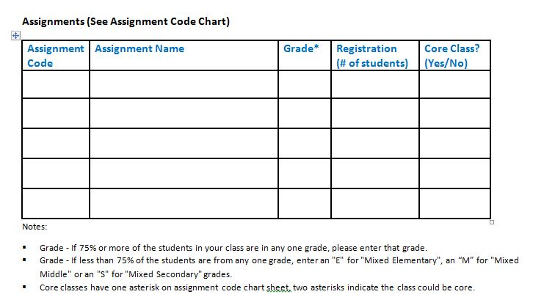

Slide 7
Using Multiple Data Points to Inform SLOs
This page on engageny describes this process in detail.
https://www.engageny.org/resource/july-2014-nti-using-multiple-data-sources-inform-target-setting-slos
Dave Scalzo also did a presentation on August 20th for New Administrators

Slide 8
Level 1 Data Warehouse Reports
These reports are available to allow teachers to see a breakdown of how their current students did on last springs assessments.
You can ask your CIO/DDC to pull these for your teachers.

Slide 9
Enjoy your Sessions!

