Slide 1
Blueprint for Improved Results for Students with Disabilities and Multiple Pathways
Jessie Karches & Maryanne White
May 16, 2016

Slide 2
E1B Leadership Conference
August 11, 2016
at Erie 1 BOCES Education Campus
Multiple sessions throughout the day that highlight current work/topics in district

Slide 3
DATES FOR NEXT YEAR
New Administrator Workshops
August 22, 2016 –Full Day
December 14, 2016 – Full Day
E1B 2016-2017 Administrator Series
October 13, 2016
December 7, 2016
February 9, 2017
May 23, 2017

Slide 4
Targets for Today’s Presentation:
What does the Blueprint for Improved Results for Student with Disabilities mean for students, teachers, and administrators in our district?
What is our action plan to address areas of need in our district that are outlined within the Blueprint discovered thorough self evaluation?
How might the Blueprint impact Teacher Evaluation?
How are the Graduation requirements for all students changing? Who needs to know about them ?
What are the implications to current practice?
Notes:
Steve

Slide 5
Teacher Standards Addressed:
Standard 1: Knowledge of Students & Student Learning
1.1 Knowledge of child and adolescent development, including students’ cognitive, language, social, emotional, and physical developmental levels
1.2 Knowledge of current, research-based knowledge of learning and language acquisition theories and processes
1.3 Knowledge of and responsive to diverse learning needs, interests, and experiences of all students
1.4 Knowledge of individual students from students, families, guardians, and/or caregivers to enhance student learning
1.5 Knowledge of and responsive to the economic, social, cultural, linguistic, family, and community factors that influences their students’ learning
Standard 6: Professional Responsibilities and Collaboration
6.1 Upholds professional standards of practice and policy as related to students’ rights and teachers’ responsibilities
6.2 Engage and collaborate with colleagues and the community to develop and sustain a common culture that supports high expectations for student learning
6.3 Communicate and collaborate with families, guardians, and caregivers to enhance student development and success
6.4 Manage and perform non-instructional duties in accordance with school district guidelines or other applicable expectations
6.5 Understand and comply with relevant laws and policies as related to students’ rights and teachers’ responsibilities
Standard 7: Professional Growth
7.1 Reflect on their practice to improve instructional effectiveness and guide professional growth
7.2 Set goals for and engage in ongoing professional development needed to continuously improve teaching competencies
7.3 Communicate and collaborate with students, colleagues, other professionals, and the community to improve practice
7.4 Remain current in their knowledge of content and pedagogy by utilizing professional resources
Notes:
Steve

Slide 6
Lead Evaluator
New York State Teaching Standards and Leadership Standards
Evidence Based Observation Techniques Grounded in Research
4. Application and use of approved Teacher Rubric
9. Specific considerations in evaluating teachers and principals of ELLs and students with disabilities
Notes:
Steve

Slide 7
Danielson Domain 1
1b – Demonstrating Knowledge of Students
Knowledge of Child and Adolescent Development
Knowledge of Students’ Special Needs
1c- Selecting Instructional Outcomes
Suitability for Diverse Learners
1d – Demonstrating Knowledge of Resources
Resources for Students
Notes:
Jessie

Slide 8
Danielson Domain 4
4b- Maintaining Accurate Records
Student Progress in Learning
4c- Communicating with Families
Information About the Instructional Program
Information About Individual Students
Engagement of Families in the Instructional Program
Notes:
Jessie

Slide 9
Blueprint for Improved Results for Students with Disabilities

Slide 10
Essential Understandings

Slide 11
TEXT TO: 22333 MESSAGE: JESSICAKARCH573
WEBSITE https://pollev.com/surveys/6wUbzmQdZ

Slide 12
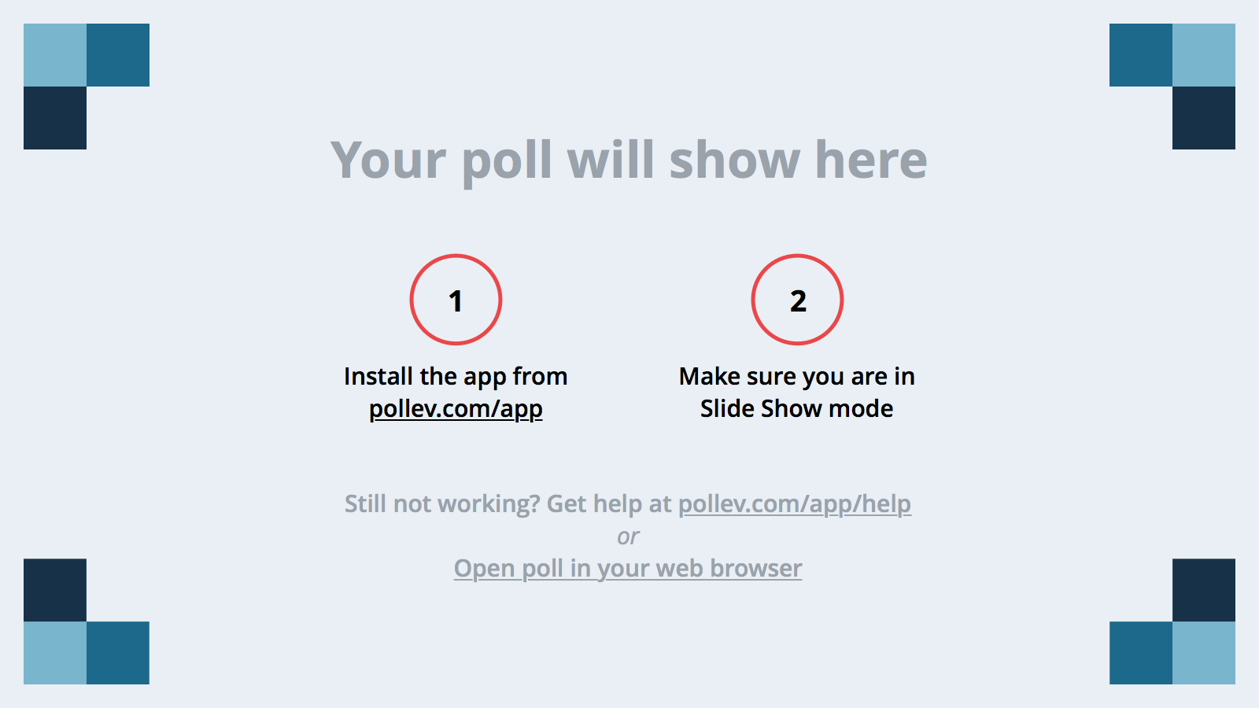
Notes:
Poll Title: Students with disabilities are held to high expectations and given the appropriate supports and services to meet those high expecations. https://www.polleverywhere.com/multiple_choice_polls/SpIzwVcbGVpONd9

Slide 13
Notes:
Poll Title: School principals are fundamentally serving as instructional leaders for students with disabilities https://www.polleverywhere.com/multiple_choice_polls/r6NVV0v42Npajgc

Slide 14
Notes:
Poll Title: Special Education administrators are fundamentally serving as instructional leaders for students with disabilities https://www.polleverywhere.com/multiple_choice_polls/mQP36k5R3uYcFgH

Slide 15
Notes:
Poll Title: Students with disabilities are participating, to the maximum extent possible, in making recommendations for supports and services needed for their academic success and to meet their post-secondary transition goals https://www.polleverywhere.com/multiple_choice_polls/5xkewWrvwChKOa0

Slide 16
Notes:
Poll Title: Students and parents of students with disabilities are being provided with information and support to be meaningfully involved in the special education process https://www.polleverywhere.com/multiple_choice_polls/IPTWbKOsJrNaz5k

Slide 17
Notes:
Poll Title: All teachers are teachers of students with disabilities and every teacher needs to be skilled in how to support and provide differentiated and specially-designed instruction to students with disabilities https://www.polleverywhere.com/multiple_choice_polls/JqFFaW4wGGPATlc

Slide 18
Notes:
Poll Title: Communities, boards of education, district and school leaders are providing systemic supports and professional development for teachers to meet the needs of students with disabilities, including appropriate identification and ensuring classrooms have necessary supports, rigorous and relevant learning environments and classroom and school-wide approaches are created to maintain a positive climate https://www.polleverywhere.com/multiple_choice_polls/Fko01QtkpxWuX4H

Slide 19
Self Reflection
Where do you fall?

Slide 20
What principles/bullets did you rate yourself as an area of weakness?
Create a poster that addresses needs/ ideas and recommendations
Elementary Principals
Middle Principals
High Principals

Slide 22
Return to your tables.
Discuss with your district or table group:
*Who needs to know about the principles? *What are the implications to current practice?

Slide 24
NYS “Pathways to Graduation” Update
Requirements | “CTE Pathway” | “CDOS Pathway” (Not Yet Official, Public Comment Period) | “CDOS Credential”
Exit Award | Regents Diploma and Technical Endorsement | Regents Diploma and CDOS Credential | CDOS Credential (stand-alone credential or in addition to a Regents or Local)
Eligibility | All Students | All Students | IEP Designated Students
 | Please note, NSYAA students are not eligible for CDOS.
Required Credits | 22 Credits | 22 Credits | None
Required Regents Exams | Pass the 4 required Regents exams: ELA Math Science Social Studies | Pass the 4 required Regents exams: ELA Math Science Social Studies | No Regents exam requirement but students need to have access to Regents coursework
CTE Requirements | Successful completion of an SED Approved CTE program that includes: Min. 3 credits of CTE Instruction (3.75 available at E1B) WBL Experiences 3-Part Industry-Based National Technical Assessment Employability Profile | Complete the requirements for the CDOS Credential: Career Plan CDOS Learning Standards 1, 2, 3a 216 hours of CTE Coursework Successful Completion 54 Hrs Min in WBL Employability Profile | Complete the requirements for the CDOS Credential: Career Plan CDOS Learning Standards 1, 2, 3a 216 hours of CTE Coursework Successful Completion 54 Hrs Min in WBL Employability Profile
Available at Erie 1 BOCES | E1B Approved Technical Assessments: Auto Technician Training Collision Repair Criminal Justice Cybersecurity and Networking Early Childhood Education Electronics and Computer Repair Engineering and Robotics Television and Sound Production Welding | CDOS components (excluding the Career Plan) are embedded in all CTE programs including Career Exploration and Occupational Education II. Students enrolled in the Northtowns Academy ALP and Special Education Programs and participating in Business and Marketing course work will also qualify for this option. | CDOS components (excluding the Career Plan) are embedded in all CTE programs including Career Exploration and Occupational Education II. Students dually enrolled in Erie 1 BOCES’ Special Education and Career and Technical Education qualify for this option.

Slide 25
Thinking Skills
Can Read
Can Write
Perform Math Functions
Listens Effectively
Speaks Clearly
Can Think Creatively
Uses Decision Making
Skills
Thinking Leads to
Problem Solving
Knows How to Learn
Applies Knowledge to
New Situations
Technology
Basic
Skills
Selects /Applies
Technology
Maintains
Equipment
Designs and Creates
To Meet Needs
Interpersonal Skills
Career Development and Occupational Studies
Standard 3A
Universal Foundation Skills
Systems
Teaches Others
Serves Clients
Exercises Leadership
Negotiates/Communicates
Works as a Member of a Team
Works with Diversity
Improves & Designs Systems
Monitors & Corrects Performances
Understands How Systems Perform
Related to Goals, Resources and
Organizational Function
Managing Resources
Personal Qualities
Managing Information
Understands
how to use:
Materials
Facilities
Time
Money
Human Resources
Networking
Demonstrates:
Responsibility
Ability to Plan
Ability to Take Independent Action
Integrity/Honesty
Self-determination and ability to
self-evaluate knowledge, skills and
abilities
Acquires and Evaluates
Information
Organizes/Maintains Information
Interprets/Communicates Information
Uses Computers to Enter, Modify,
Retrieve and Store Data
Notes:
Materials: CDOS graphic
This slide is a graphic representation of the CDOS 3a. Standards.
Trainer has discretion on how you want to use this.
Suggestions:
Which of the skills are taught directly or indirectly in schools?
Which of these skills did you need for your first job? Your current job?
Which of these skills did participants needs to make it to the training today?
What skills do you feel you are training your students on now?
What are you teaching in school that can be helpful when placing students on the worksites?

Slide 28
Text Tag
Place a * next to something that helps answer the Questions:
Who needs to know this information?
How will this change our current practice?
Place a ! Next to something you find very important
Place a ? Next to something you want to know more about

Slide 29
Questions ??????
Thank you for attending!

