Slide 1
Inter- Rater Reliability and the Co-Teaching Classroom
Steve Graser & Jessie Karches

Slide 2
Activate and Engage
This is the first year for Ms. Collins (general educator) and Mr. Parker (special educator) to co-teach. In the classroom, the door reads, “Welcome to Ms. Collins’ Classroom!” Ms. Collins reviews the agenda at the beginning of the class period, then Mr. Parker comes in 5-10 minutes later and works quietly with a few students with IEPs while Ms. Collins lectures in front of the class.
Identify 3 ways parity can be established in this classroom.

Slide 3
Lead Evaluator Certification Criteria
Evaluator Training and Certification 30.29 (b)
2. Evidence Based Observation Techniques
4. Application of APPR Rubrics
9. Evaluating Teachers and Principals of Students with Disabilities

Slide 4
Agenda
Explore and Discover:
- Why Co-teaching?
- What is Co- Teaching?/ What is Not?
- Types of Co-Teaching Models
Explore and Discover:
- Three Stages of Co-Teaching Self Assessment Tool Cross walked with Danielson’s Rubric
Explore and Discover:
-Writing Growth Producing Feedback
Organize and Integrate:
Video: 6th Grade Math Co- Teaching Model- evidence and feedback

Slide 5
What is Co- Teaching?
Both teachers take part in
planning
teaching
evaluating students ’ performance
Co-Teaching is two or more professionals delivering substantive instruction to a diverse or blended group of students in a single space.
Friend & Cook, (1995). Co-Teaching: Guidelines for creating effective practices. Focus on Exceptional Children

Slide 6
Specially Designed Instruction
“Special Education is instruction that is more urgent, more intensive, more relentless, more precisely delivered, more highly structured and direct, and more carefully monitored for procedural fidelity and effects”
- J.M. Kauffman

Slide 7
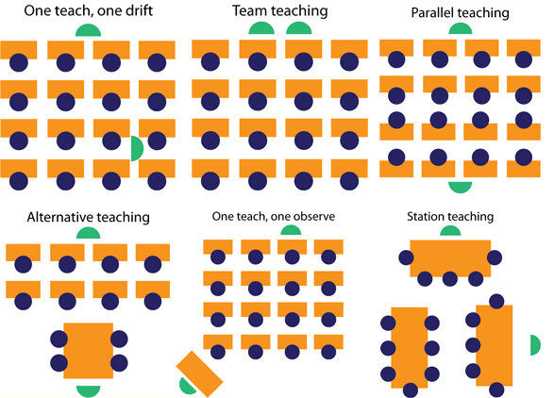
Models of Co-Teaching
Station Teaching – Frequent
Parallel Teaching – Frequent
Alternative Teaching - Occasional
Teaming – Occasional
One Teach, One Observe – Seldom
One Teach, One Assist - Seldom
Friend, 2008

Slide 8
Co-teaching approaches
Try a variety of approaches, even in the same day/lesson
Don’t rely on “one teach, one assist” too frequently
* Role of support teacher becomes more like a
paraprofessional
* Students don’t benefit from having 2 credentialed
teachers in the classroom

Slide 9
Why?
Only 1 in 20 (5% of) students are formally identified with specific learning disabilities. Another 15% struggle in school due to unidentified learning and attention issues.

Slide 10
Review of co-teaching approaches
While Ms. Acker reviews yesterday’s homework with most of the students, Ms. Vaughan works with a small group of students to review concepts they did not master on an assessment.
Team Teaching
Parallel Teaching
Alternative Teaching
Station Teaching

Slide 11
Review of co-teaching approaches
Mr. Johnson leads a small group of students discussing a novel about the industrial revolution. Ms. Boxer leads a small group to review material from the textbook. Another small group independently examines old newspapers and pictures from the early 1900s. The students rotate to all 3 groups.
Team Teaching
Parallel Teaching
Alternative Teaching
Station Teaching

Slide 12
3 Stage Rubric on Co-teaching

Slide 13
Cross Walk between Three Stage Co-Teaching Rubric and Danielson’s Rubric
1. Work as table to complete the graphic organizer that aligns Danielson’s Domains and Elements to the Three Stage Rubric.
2. JIGSAW the critical attributes at the table
Discuss: Where there any conflicts?

Slide 14
Feedback is information about how we are doing in our efforts to reach a GOAL. It is neither ADVICE nor a performance EVALUATION. Wiggins 2012

Slide 15
7 Keys to Effective Feedback

Slide 16
7 Keys to Effective Feedback (Grant Wiggins, 2012)
1. Goal Referenced
2. Tangible and Transparent
3. Actionable
4. User Friendly
5. Timely
6. On-Going
7. Consistent

Slide 17
ADVICE
EVALUATION
ADVICE

Slide 18
Practice
Goal | Example of Feedback | Non-Example
4.3 Positive Behavioral Supports are Evident on an Ongoing Basis | Only one teacher provided positive feedback to a specific student, and positive feedback was only given twice throughout the lesson. The student received 5 reminders from the other teacher. The student behavior was most appropriate immediately after the positive feedback. | Use positive behavioral feedback on a regular basis. (ADVICE)

Slide 19
Co-Teaching Math Class
Co-Teaching Video
Co-Teaching Video through Vimeo
Co-teaching video reflection based on IP.doc

Slide 20
Wrapping Up
Co-teaching involved shared responsibility between 2 teachers to meet the needs of ALL students in the classroom.
Administrative support is important to the success of co-teaching.
Growth Producing feedback allows teachers to advance their co-teaching practice

