Slide 1
What’s in the Data Warehouse?
Timothy Johnson
Dave Scalzo
Elizabeth Freas

Slide 2
What’s in the Data Warehouse
Level 1 Reports
Level 1 Cubes
Level 2 Reports

Slide 3
WNYRIC DATA FLOW: TOTAL VIEW
L2RPT reports
(Tues)
Via
WNYRIC Cognos Portal
dataview.wnyric.org
PD
Reports
(Refresh Wed)
PD System
Data Reporting
Components
SIRS Level 2 Production/Summary Tables
SED SIRS Level 2 Staging Tables
NYSSIS System:
Request files new IDs/
Response Files
(Daily)
NYSED Level L1C
L1C:Deadline:
Current data by EOD on Friday/historical on Thursday.
LVL 1 Regional
Reports
And Cubes via
WNYRIC Cognos Portal
dataview.wnyric.org
L1C Errors:
Data exists
in level 1 but
was not accepted
by L1C /LVL2.
Need to correct
in SMS/LVL 0
(Weekly)
WNYRIC Regional Level 1 DW
(Data Visible w/in 48 hours of
lock in level 0)
WNYRIC LVL 1 Weekly Data
Collection Deadline:
Lock current year data in LVL 0 by
Thurs. at noon & historical by noon Wed.
Level 0
Monthly Data Extracts
Test Scoring
Scan Files as
collected
Clear Track/IEP Direct and
other Program Service Data
SMS Data

Slide 6
3-8 Instructional Reports
Item Response Analysis per student
Summary Score Report
Performance Report w/ Gap Analysis
Constructed Response Distribution of Points
Released Question Performance Report
Scatter plots

Slide 9
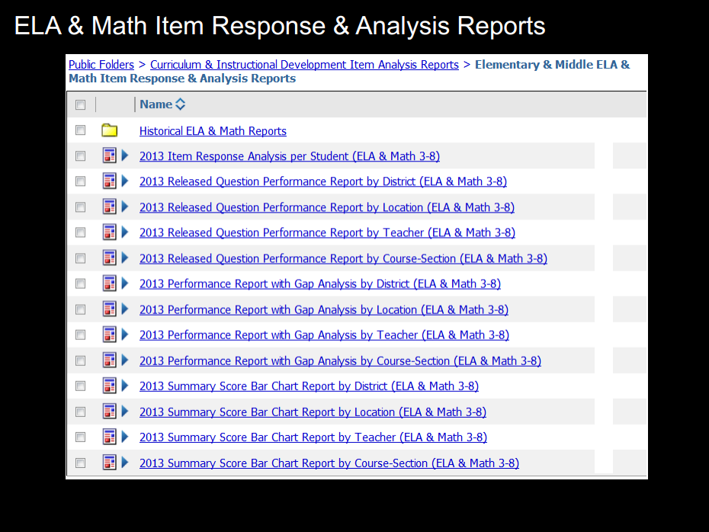

Slide 13
ERReleased questions can be found on engageNY

Slide 14
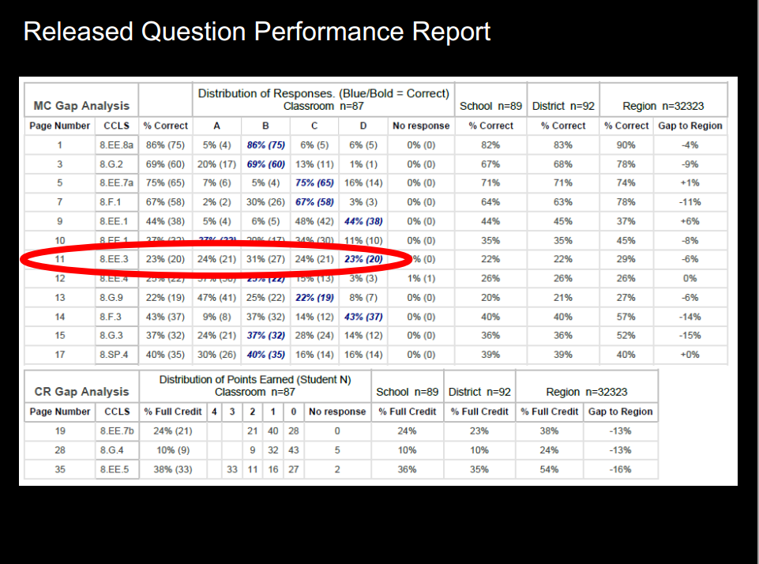

Slide 15
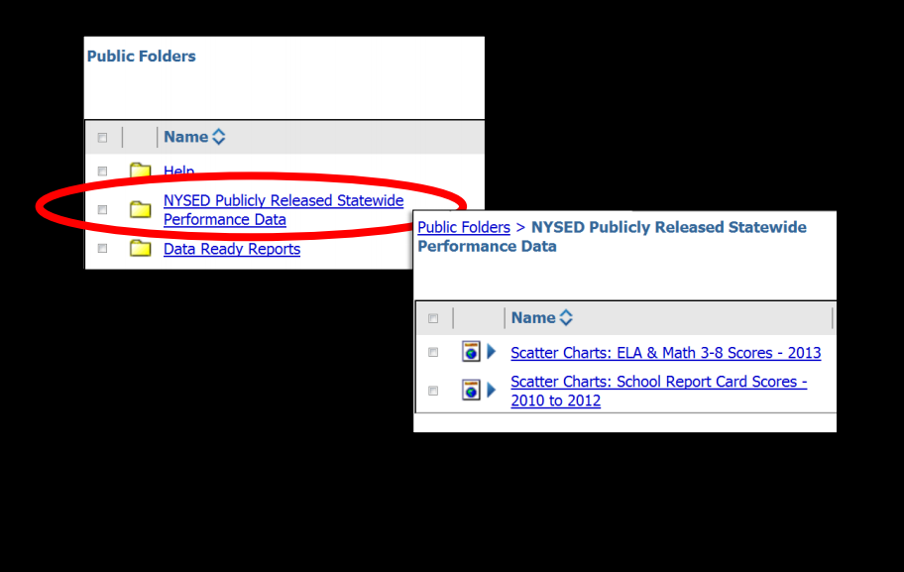
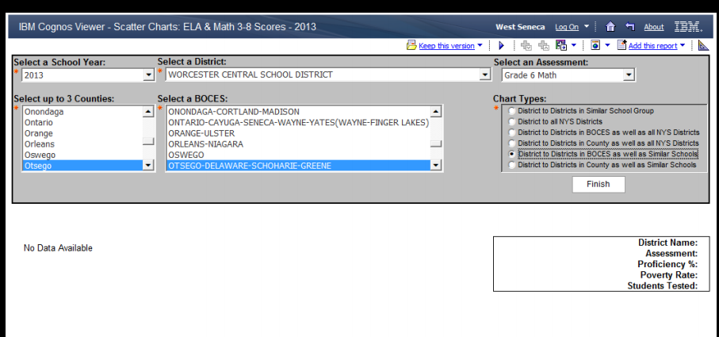

Slide 16
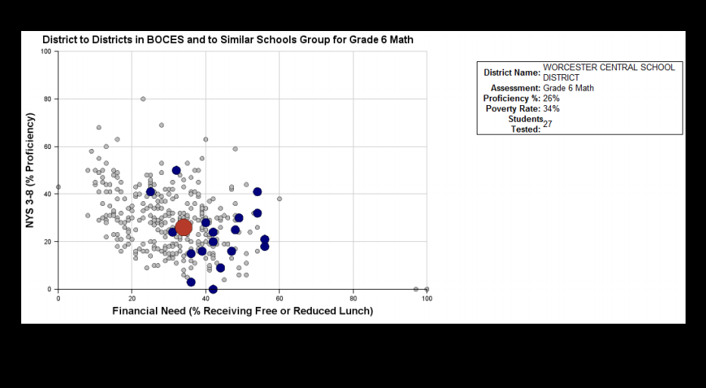
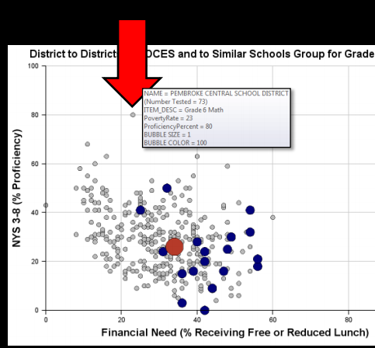

Slide 17
What does it look like for High School?

Slide 18
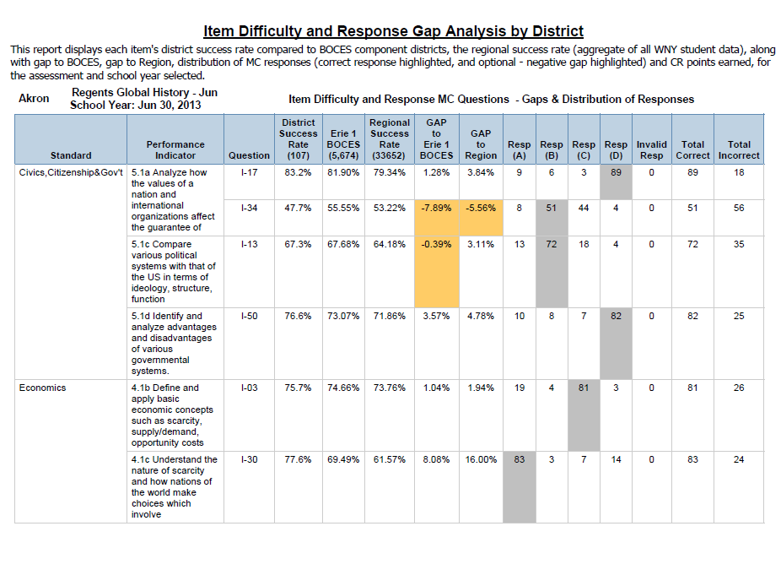

Slide 19
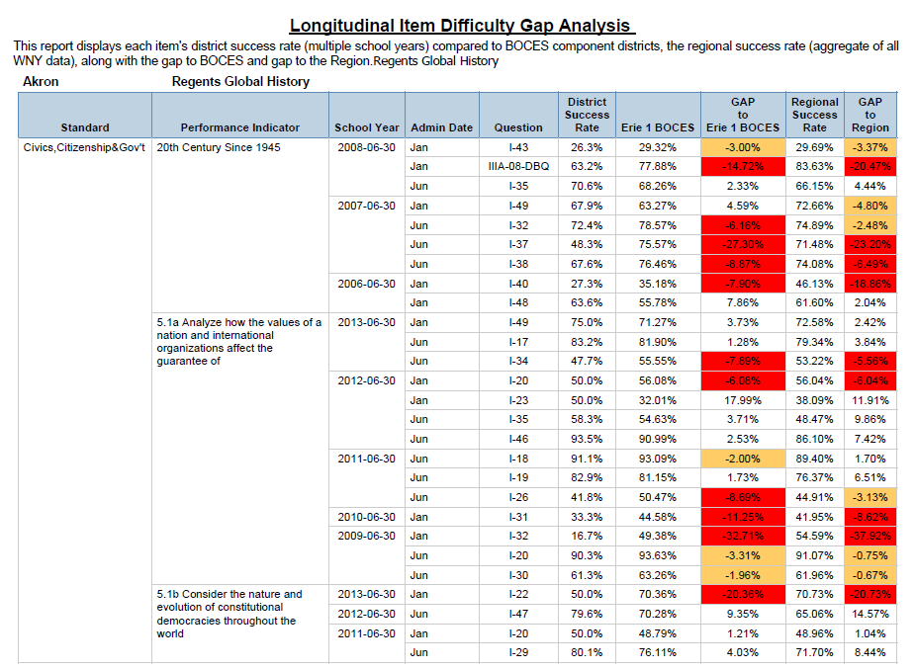

Slide 23
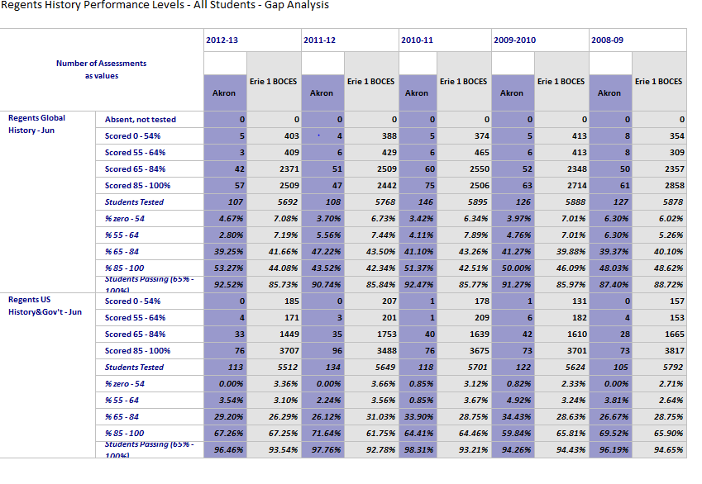

Slide 24
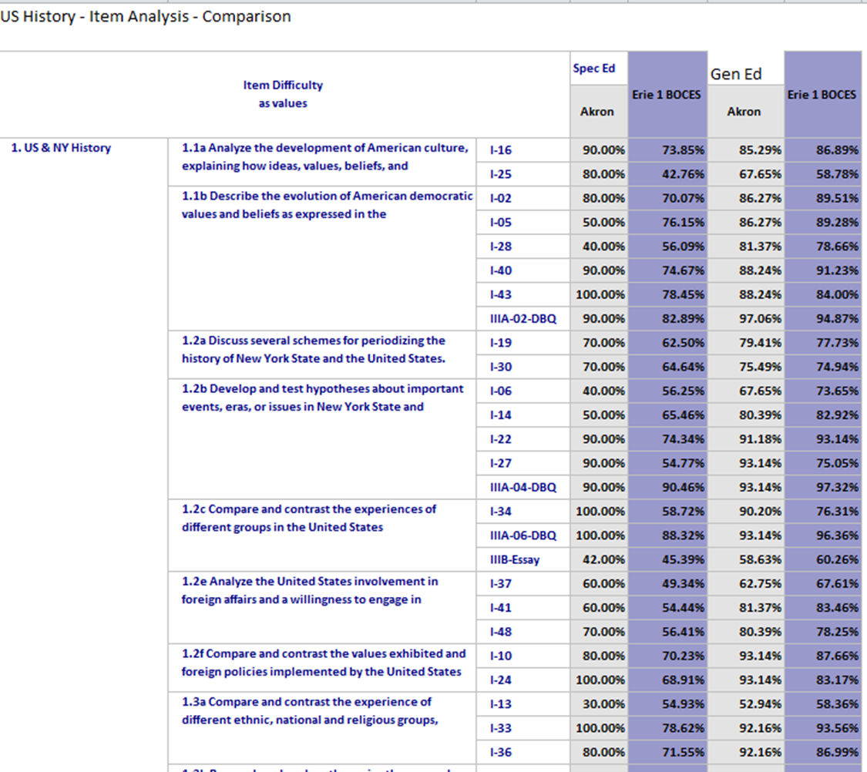

Slide 26
Opening Page

Slide 27
Accountability Folder

Slide 28
SIRS 101 Screen Shot

Slide 29
Annual Outcomes

Slide 30
SIRS 309 Screen Shot

Slide 31
Reports than lead to DDI

Slide 32
Contacts
Erie 1 BOCES Data Consultant Team
Timothy Johnson
tjohnson@e1b.org
David Scalzo
dscalzo@e1b.org
Elizabeth Freas
efreas@e1b.org

Slide 33
Data Driven Instruction

Slide 34
Data Driven Instruction: Critical Attributes
Systematic
Introductory and on-going professional development on DDI
Implementation calendar
Uncommon Schools
Highly active leadership team

Slide 35
Data Driven Instruction: Critical Attributes
Assessments
Common interim assessments (every 6-8 weeks)
Transparent starting point (teachers have assessments in hand prior to instructional period)
Focused (most critical content and skills are more heavily assessed)
Through (covering curriculum taught from beginning year to assessment date)
Best practice – item writing (plausible distractors, level of rigor, conventions or rules)
Notes:
Entry Point: Assessment development PD required

Slide 36
Create a Scope & Sequence
Identify and list the standards/content/skills covering a given period of instruction
Denote each standard by level of importance (Data, state recommendations, endurance, leverage, results from prior assessments…)

Slide 37
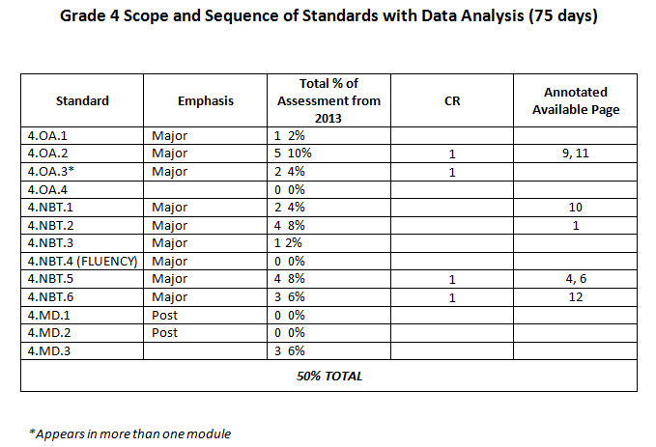
Create a Scope & Sequence

Slide 38
Create the Blueprint
Determine the length/type of the assessment.
# of multiple choice
# of constructed response
Project
Performance
Determine distribution of questions by standard.
Emphasis designation (major, supporting, additional)
Data from state, classroom, and third party assessments
Endurance and leverage of content and skill
Teacher recommendation hierarchy of importance
Grade 4 Math Example
Notes:
Assessment type should be determined based on content and skills assessed.

Slide 39
Assessment
Assessment aligns to the blue print
Grade 4 Math Interim

Slide 40
Annotation
Provides correct answers and/or rubric for scoring
Rational is provided for incorrect distractors
Grade 4 Annotation

Slide 41
Data Driven Instruction: Critical Attributes
Analysis
Immediate turnaround (ideally 48 hours)
Data reports (performance, item analysis, standards reports)
Step 1: Collect and Chart Data
Step 2: Analyze Strengths and Weaknesses
Test in hand (when reviewing data teachers should have a copy of the assessment questions/student work)
Deep analysis (going beyond right and wrong answers to infer misconceptions)
Step 2: Analyze Strengths and Weaknesses
Step 3: Goals

Slide 42
Data Driven Instruction: Critical Attributes
Action
Planning (new lessons and strategies based on data analysis)
Step 3: Goals
Step 4: Instructional Strategies
Implementation (action plans for whole class, small group and individuals)
Step 4: Instructional Strategies
On-going assessment (formative in the classroom between interim assessments)
Step 5: Results Indicators
Accountability (instructional leader [coaches, math chairs, etc.] review, observe and provide feedback on lessons related to action plans)
Step 5: Results Indicators
Engage students (students know end goal and the actions being taken to improve)
Step 3: Goals

Slide 43
Obstacles
Time
Administrative support
Collegial environment among professional/unprofessional colleagues
Team buy-in

Slide 44
Q and A
Next Steps

