Slide 1

Communicating with students
February 11, 2016

Slide 2
Agenda
I. NYSED Updates
    APPR
    Testing
Alignment (Teaching Standards, Lead Evaluator, Danielson)
Research and Best Practice
Inter-Rater-Reliability

Slide 3
APPR Updates
Office of Teacher/Principal Quality and Professional Development

Slide 4
At their December 2015 meeting, the Board of Regents adopted sections 30-2.14 and 30-3.17 of the Rules of the Board of Regents providing for APPR transition scores and ratings for the 2015-16 through 2018-19 school years.
During the transition period, LEAs must calculate both original and transition scores and ratings.
The results of grades 3-8 ELA/math State assessments and any State-provided growth scores must be excluded from the transition score/rating calculations.
State-provided growth scores and the original scores and ratings must still be provided for advisory purposes.
4
Notes:
9-12 can’t use building wide measure (i.e., principal growth score) but can still use SLOs with the Regents exams
Can still use NYSAA and NYSELAT
Target setting with NYSAA-there will be a conversion chart, continue to target set as you have before

Slide 5
2015-16 School Year Requirements: §§ 3012-c and 3012-d
Districts/BOCES must continue to calculate scores and ratings pursuant to the approved APPR plan (i.e., the “original” scores and ratings).
Districts/BOCES will also calculate transition scores and ratings that exclude the results of 3-8 ELA/math State assessments and any State-provided growth scores.
The overall transition scores and ratings will be determined based upon the remaining subcomponents of the APPR that are not based on the grade 3-8 ELA or math State assessments or a State-provided growth score on Regents exams.*
* The Department anticipates returning to the Board of Regents at its February 2016 meeting with proposed regulatory changes that will provide districts implementing APPR plans pursuant to Education Law §3012-d during the 2015-16 school year the same protections that the new transition regulations provide districts implementing APPR plans pursuant to Education Law §3012-c during the 2015-16 school year.
5
Notes:
Last bullet is different from what was adopted by the BOR in December

Slide 6
2016-17 through 2018-19 School Year Requirements
Districts/BOCES must continue to calculate “original” and transition scores and ratings.
The overall transition scores and ratings will be determined based upon the remaining subcomponents of the APPR that are not based on the grade 3-8 ELA or math State assessments or a State-provided growth score on Regents exams.
Where no scores or ratings in the subcomponents of the Student Performance Category can be generated, an alternate SLO must be developed using assessments approved by the Department that are not 3-8 ELA and math State assessments.
6
Notes:
It is assumed all will be at 3012(d)
If already approved 3012(d) the department will being releasing a form, an addendum to come into compliance with these requirements. The form will require signatures

Slide 7
What Are Some Assessment Options for Alternate SLOs?
Assessment options include:
  Grades 4 and 8 State Science assessments
  Regents examinations (so long as not using the State-provided growth score)
  State-approved third-party assessments*
  State-approved district, regional, or BOCES-developed assessments*
During the transition period, common branch teachers will not be required to have at least one math and one ELA SLO.
Alternate SLOs during the transition period may utilize district-wide measures (i.e., measures based on assessments administered outside of an educator’s building).
*In order for third-party and locally-developed assessments to be used for evaluations under Ed. Law §3012-d, an application must be submitted to the Assessment RFQ. The Department is reviewing these applications in an expedited manner and the requirements for assessments for use with SLOs were revised on September 18, 2015 to significantly reduce the amount of information that applicants need to provide.
7
Notes:
District measure still can’t use 3-8 ELA and/or math
Currently only state assessments are to be used for a building-wide/school/group or team measure. This change is being considered by the department
For 2016-17 and forward-3rd grade teachers still have to set a SLO using the 3rd grade ELA and math test. They will also need another student performance measure that does not include the 3-8 ELA and/or math assessments
3012(d) 4-8 ELA and math (2016-17, 2017-18, 2018-19)
Overall: transition SLO that does not use the state 3-8 ELA or math assessments
Original (state provided growth score): state-provided growth score and an alternate SLO
“You are still expected to implement your plan as approved. In the plan you had approved you attested that there will be back-up SLOs for 3-8 ELA and math. Even though you will not be using these scores for transition scores, you are still required to have them for the advisory score reasons during the transition period”

Slide 8
Impact on Hardship Waivers and Approved §3012-d plans
Hardship Waivers will be automatically renewed for all districts that are currently implementing a §3012-c APPR plan pursuant to a Hardship Waiver that was approved by the November 15, 2015 deadline.
Districts must still have a §3012-d APPR plan approved by the Department by September 1, 2016 to maintain eligibility for State aid increase.
  Districts should submit their §3012-d APPR plans by July 1, 2016 to ensure approval by September 1, 2016.
  The APPR portal is being updated for the 2016-17 school year to accommodate entry of alternate SLOs during the transition period.
If your district/BOCES already has an approved §3012-d APPR plan, that plan does not need to be revised for the 2015-16 school year as a result of the new regulations.
  Instead, your district/BOCES will have to submit a supplemental form describing the alternate SLOs that will be used during the transition period so that you do not need to re-open the entire APPR plan. Further information about this form will be posted on EngageNY.
8
Notes:
3012(d) plan to SED by July 1 to get approval by Sept 1
Alternate SLO form, for those with approved 3012(d) plans will be available in March

Slide 9
TIPs, PIPs, and Data Submission and Reporting
For all employment related decisions and TIP/PIP determinations, districts/BOCES must use the overall composite transition rating.
For the purposes of reporting staff evaluation data to the Department, districts/BOCES must calculate and provide both the original and transition scores and ratings.
  The reporting template is being updated to accommodate this change.
For purposes of disclosure to parents/guardians upon their request, both the original composite score and/or rating and the overall transition composite score and/or rating along with an explanation of the transition score/rating.
The Public Data Access Site will be updated to report both original and transition ratings.
9
Notes:
3012(d)
Teacher is rated D or I during the transition “overall” score
Same teacher is rated as E with original score
Could the teacher appeal? Locally determined

Slide 10
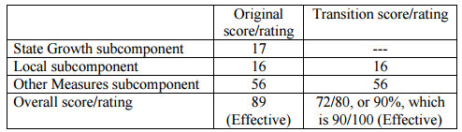
 | Original score/rating | Transition score/rating
State Growth subcomponent | 8 | ***
Local subcomponent | 8 | 8
Other Measures subcomponent | 56 | 56
Overall score/rating | 72 (Developing) | 64/80 or 80%, (Effective)

Slide 11
 | Original score/rating | Transition score/rating
State Growth subcomponent | 1 | ***
Local subcomponent | 17 | 17
Other Measures subcomponent | 56 | 56
Overall score/rating | 74 (Developing) | 73/80 or 91%, (Highly Effective)
 | Original score/rating | Transition score/rating
State Growth subcomponent | 19 | ***
Local subcomponent | 4 | 4
Other Measures subcomponent | 54 | 54
Overall score/rating | 77 (Effective) | 58/80 or 73%, (Developing)

Slide 12
3-8 Testing: January 2016
Greater involvement of educators in the test development process,
Decrease in the number of test questions, and
A shift to untimed testing.

Slide 13
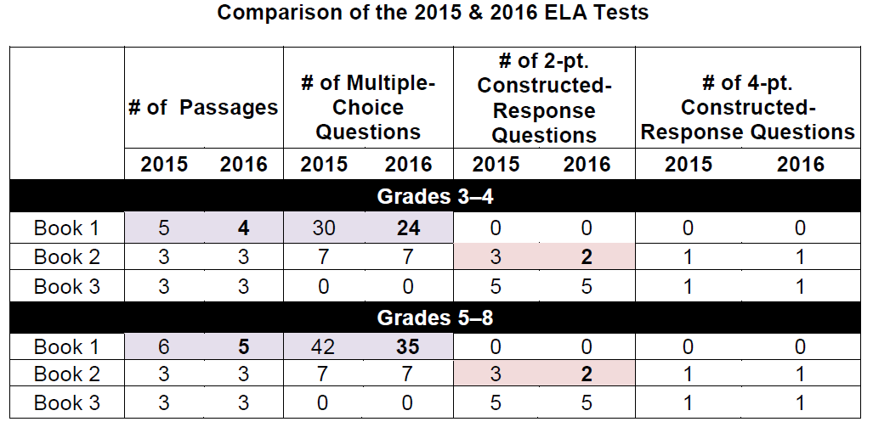
Testing Format: ELA

Slide 14
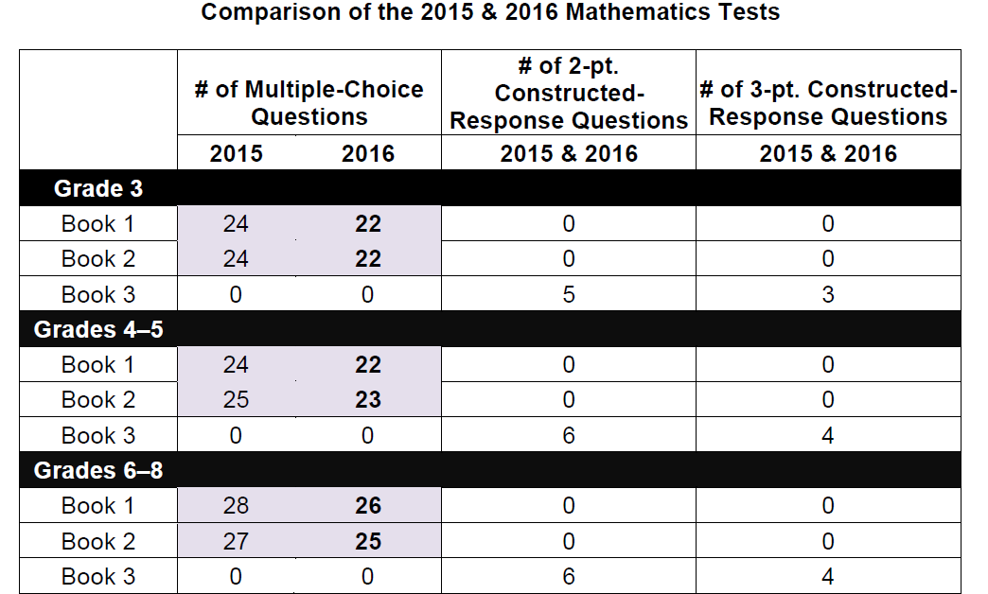
Testing Format: Math

Slide 15
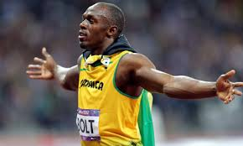
What is self fulfilling prophecy?
Notes:
Research on Bolt

Slide 16

Self Fulfilling Prophecy
Turn and Talk to your Elbow Partner:
How does “self fulfilling prophecy” and the content of the video conflict, and how do both relate to student learning experiences in school?

Slide 17
Teacher Role in Shaping student opinion
In one survey of 133 fourth-grade students from 16 urban classrooms, students were asked to rate their intelligence and then asked why they rated themselves as they did. Approximately two-thirds of respondents rated their intelligence based on the comments or actions of teachers, while only five percent of students cited peers or parents. Twenty-five percent of students said they determined their intelligence based on their own beliefs (Weinstein, 2002).
What teacher comments or actions enhance a student’s opinion of themselves?

Slide 18
Teacher Standards
3.2 Culminates clearly and accurately with students to maximize their understanding and learning
3.3 Sets high expectations and creates challenging learning experiences for students
2.1 Knowledge of the content they teach including relationships among central concepts, tools of inquiry, and structures and current developments within their disciplines
2.4 Establishes goals and expectations for all students that align with learning standards and allow for multiple pathways to achievement.

Slide 19
Lead Evaluator
1. New York State Teaching Standards and Leadership Standards
2. Evidence-based observation
3. Application and use of Student Growth Percentile
4. Application and use of the State-approved teacher or principal rubrics
8. Scoring methodology used to evaluate teachers and principals
9. Specific considerations in evaluating teachers and principals of ELLs and students with disabilities

Slide 20

Danielson Bullets
3a - Communicating with students
expectations for learning
directions and procedures
explanations of content
use of oral and written language

Slide 21
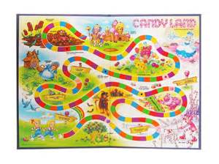
Rubric Vocabulary Game

Slide 22
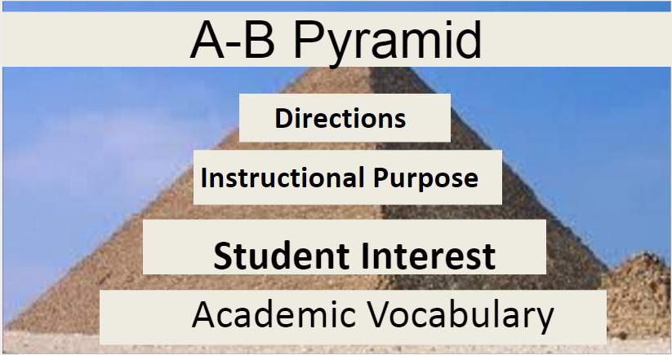

Slide 23
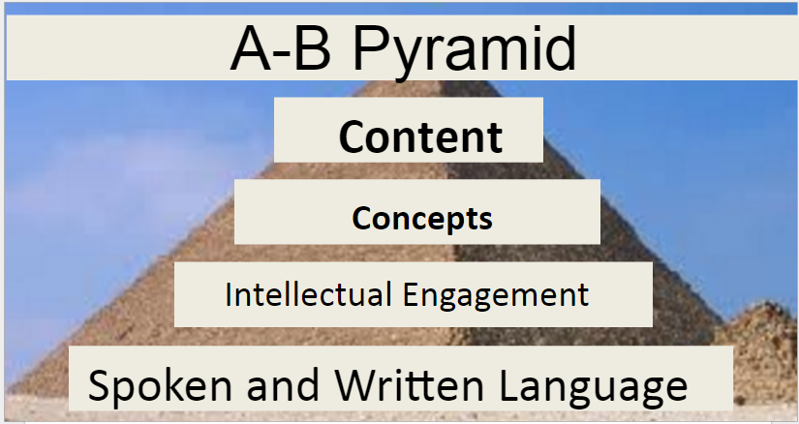
Notes:
Make sure that you talk about checking for understanding

Slide 24
Hattie’s Research
***Effect size of 0.5 is equivalent to one grade level on exam results
Influence | Effect
Setting objectives and providing Feedback | 1.13
Instructional Quality -Clear learning targets -Student engagement -Questioning and student discussion (High level) -Checking for understanding -Assessment for learning | 1.00

Slide 25
3a - Communicating with students directions and procedures
§ Students are clear about expectations during the lesson—especially during independent or group work without direct teacher supervision.
§ Directions may be provided orally, in writing, or a combination of the two.

Slide 26
3a - Communicating with students directions and procedures
The number one problem in the classroom is not discipline; it is the lack of procedures and routines
  - Harry K. Wong
  Describe strategies and the frequency that you observe teachers explicitly instructing procedures and routines…

Slide 27
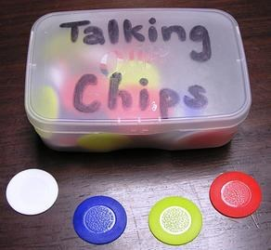
Reflecting...
Talking Chips is used for regulation of communication
Prompt: How often do you observe teachers explicitly instructing procedures and routines? What strategies are they using to do so?
You may contribute only as many times as the pieces you have. You must use your chips.

Slide 28
3a - Communicating with students explanations of content
Researcher’s found that when a teacher’s content knowledge was insecure their ability to give appropriate and effective explanations in the classroom is limited. They were more likely to behave like “ineffective” teachers. For instance, they are more likely to adopt closed and constrained pedagogy – developing the pedagogy to a more discursive style, keeping a tighter reign on what is taught, avoiding asking open-ended questions and discussion sessions, and being more authoritative in what they plan and do in class.
Pedagogy is important as well.
Pedagogical Content Knowledge is the Goal
Notes:
In mathematics, more knowledgeable teachers were more likely to present problems in contexts that were familiar to the students and to link problems to what students already learned. Teachers who understood multiple representations of mathematics concepts were able to use these representations to further students' understanding. In contrast, teachers with less mathematics knowledge tended to focus on algorithms rather than on the underlying mathematics concepts. More knowledgeable teachers tended to approach students' questions mathematically and solve problems collaboratively, rather than looking up correct answers in response to students' questions. Similarly, in science, teachers with deeper content knowledge were more likely than those with weaker knowledge to pose questions, suggest alternative explanations, and propose additional inquiries

Slide 29
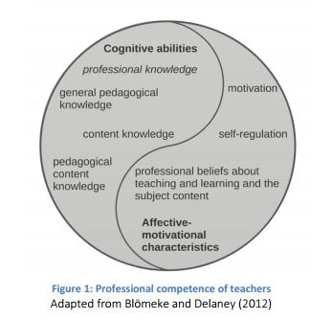
3a - Communicating with students explanations of content

Slide 30
3a - Communicating with students explanations of content
What does research say about professional knowledge of the teacher?
Stronger content knowledge teachers are more likely to use practices that can help students construct and internalize knowledge, such as
  Asking higher-level questions
  Encouraging students to explore alternative explanations
  Involving students in more inquiry based learning
  Allowing more student-directed activities
  Engaging students in the lessons
Notes:
In mathematics, more knowledgeable teachers were more likely to present problems in contexts that were familiar to the students and to link problems to what students already learned. Teachers who understood multiple representations of mathematics concepts were able to use these representations to further students' understanding. In contrast, teachers with less mathematics knowledge tended to focus on algorithms rather than on the underlying mathematics concepts. More knowledgeable teachers tended to approach students' questions mathematically and solve problems collaboratively, rather than looking up correct answers in response to students' questions. Similarly, in science, teachers with deeper content knowledge were more likely than those with weaker knowledge to pose questions, suggest alternative explanations, and propose additional inquiries

Slide 31
3a - Communicating with students explanations of content
Students of teachers in the top quartile showed gains in their scores that were equivalent to that of an additional two to three weeks of instruction
How are we currently supporting the development of teacher expertise in content?
Notes:
In mathematics, more knowledgeable teachers were more likely to present problems in contexts that were familiar to the students and to link problems to what students already learned. Teachers who understood multiple representations of mathematics concepts were able to use these representations to further students' understanding. In contrast, teachers with less mathematics knowledge tended to focus on algorithms rather than on the underlying mathematics concepts. More knowledgeable teachers tended to approach students' questions mathematically and solve problems collaboratively, rather than looking up correct answers in response to students' questions. Similarly, in science, teachers with deeper content knowledge were more likely than those with weaker knowledge to pose questions, suggest alternative explanations, and propose additional inquiries

Slide 32
3a - Communicating with students use of oral and written language
§ Teachers’ use of language represents a student’s best model of accurate syntax and rich vocabulary.
§ Teachers’ modeling of language enables students to emulate language, making their own language more precise and expressive.

Slide 33

3a - Communicating with students use of oral and written language
“Unless vocabulary becomes an integral part of everyday literacy instruction, the gap among groups will continue to widen, making it harder for low-performing groups to catch up to their peers.”
- Elleman, Lindo, Morphy, & Compton, 2009
Notes:
Studies have found that by age four, children in middle and upper class families hear 15 million more words than children in working-class families, and 30 million more words than children in families on welfare. This disparity in hearing words from parents and caregivers translates directly into a disparity in learning words. And that puts our children born with the fewest advantages even further behind. Among those born in 2001, only 58 percent of poor children started school ready to learn, compared to 75 percent of children from middle-income families.

Slide 34
3a - Communicating with students use of oral and written language
*“One of the biggest barriers to vocabulary growth in school is the simplistic way many teachers talk to children. ”
*“ … promoting incidental learning and word consciousness through frequent and deliberate modeling of sophisticated vocabulary can add substantial breadth to children's vocabularies.”
- "ERIC - The Vocabulary-Rich Classroom: Modeling Sophisticated Word Use to Promote Word Consciousness and Vocabulary Growth, Reading Teacher, 2010-Feb. By: Holly Lane, Stephanie Allen, n.d. Web. 05 Feb. 2016.
Identify one example of when you have heard a teacher simplify language rather than teach the technical (content) language…
What strategies have you have heard or seen a teacher utilize to successfully teach technical (content) language…
Notes:
Each table share

Slide 35
3a - Communicating with students
Expectations for learning
§ Goals for learning are communicated clearly to students.
§ Goals may be communicated during the lesson to help students clarify what they are learning.

Slide 36

Poll Everywhere
3a - Communicating with students
Expectations for learning

Slide 37
Ability -grouping/tracking/streaming
3a- Communicating with students Expectations for learning
Refers to whether classes are heterogeneous or homogeneous. Studies consider achievement effects and equity effects. More than 300 studies show tracking has minimal effects on learning outcomes and “profound negative equity effects.” Separate gifted programming is not considered in this set of studies.

Slide 38
Additional Facts…
3a- Communicating with students Expectations for learning
Assigning a student to a group can create a self fulfilling prophecy.
End of the year placement into groups effects parent and teacher perceptions of the student’s competency.
Ability grouping happens more often in reading than other content areas such as Math.
Results on mid-year achievement assessments can have up to a 25% variance in growth based on ability grouping (greater growth is achieved in the higher ability groups).
When in ability groups teachers are less likely to monitor individual growth.

Slide 39
And…
3a- Communicating with students Expectations for learning
Teachers working with low ability groups are less likely to take into account student interest.
Students in low ability groups are more likely to be doing seat work, worksheets, and taking tests/quizzes.
Students describe teachers of high ability groups as more patient, respectful, and clear in their presentation than teachers of low ability groups.

Slide 40
Connection to Special Education
3a- Communicating with students Expectations for learning
Congress found that “over 30 years of research and experience” demonstrated that special education would be more effective by:​
“… having high expectations for such children and ensuring their access to the general education curriculum in regular classrooms, to the maximum extent possible … to meet the challenging expectations that have been established for all children; and be prepared to lead productive and independent lives to the maximum extent possible.” (20 U.S.C. 1400(c)(5); page 46, Wrightslaw: Special Education Law)
Notes:
Talk about Memo

Slide 41

How Do Teachers' Expectations Affect Student Learning
By D. Stipek — Pearson Allyn Bacon Prentice Hall
Notes:
Cause (Teacher Behavior)​
Effect (Student Learning)​
Model is about tracking​
​
​
Marzano – Cause and effect blurb

Slide 42

= I know this!
= This is important to me!
?
=Would like more info about this!
Focused Reading
Notes:
Suggested Language: “Paraphrasing is brain-compatible. The paraphrase sends a message I am not attacking you. Allows blood flow to neo-cortex instead of to brain stem and limbic system. Peptides located throughout body carry messages in blood stream, positively affects body chemistry.”
Strategy: Focused Reading
OR
Strategy: Partners Paraphrase
Designate an A and B.
Beginning on page 47 in the LG, Paraphrasing, read the first paragraph, silently simultaneously.
After reading, A will paraphrase.
Read the next paragraph and B will paraphrase.
Continue pattern until the end of the page

Slide 43

Expectations For Learning
3a - Communicating with students
Expectations for learning
Poll Everywhere…
DataWorks Video
Notes:
Is stating or making the objective visible enough? Or does it need to be taught?

Slide 44

Also, Marzano’s Action step 5: when low-expectancy students do not answer a question correctly or completely, stay with them
3a- Communicating with students Expectations for learning

Slide 45
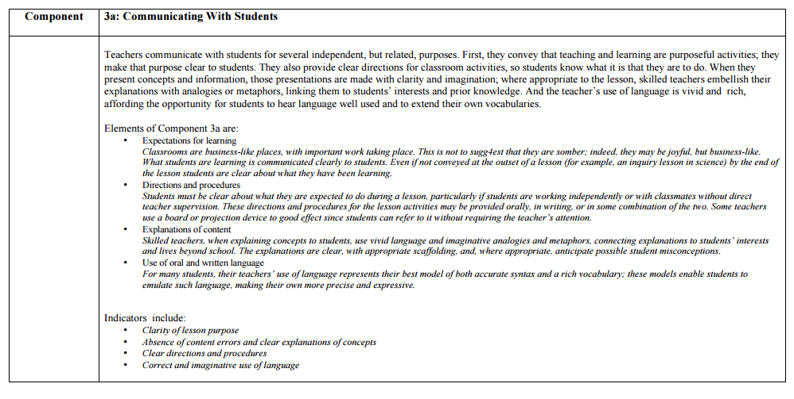
Danielson’s Communicating with Students – Inter Rater Reliability

Slide 46


