Slide 1
New Administrators Preparation
E1B Network Team Professional Development

Slide 2
Group Norms
‘Clear Your Plate’
Limit side conversations
Silence your devices
Actively participate
Help to quiet room – raise hands
We will take technology breaks

Slide 3
Today’s Meet
https://todaysmeet.com/NewAdminPrep

Slide 4
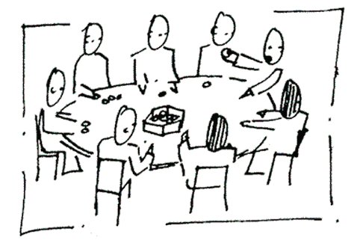
Today’s Focus
Teaching Standards
Inter-Rater Reliability
SLO’s
Growth Scores
Data Warehouse

Slide 5
Pre Assessment Activity
Teaching Standards Graphic Organizer
3 minutes independently work to fill in teaching standards and anticipatory set questions
3 minutes to work with the table to fill in blanks and discuss

Slide 6
Why Teacher Standards ?
Aligned to improving teaching and learning initiative
Used to develop performance based test for new teachers
Used to enhance APPR process
Creating teacher career ladder and teacher professional development

Slide 7
How were they developed?
Who: NYSUT, NYSED, and broad range of stakeholders
Each stake holder group shared unique personal perspective
Composed a draft and presented to Board of Regents

Slide 8
Research
Classroom Assessment Scoring System (CLASS)
Danielson- Framework of Teaching (2007)
Interstate Teacher Assessment Support Consortium (InTASK)
National Board for Professional Teaching Standards (NBPTS)
Uncommon Schools- Taxonomy
Measures Effective Teaching (METS)
Other states

Slide 9
Standards
Broad area of knowledge/skills that research has shown to be essential
Knowledge of Students & Student Learning
Element 1.1 Demonstrate knowledge of child and adolescent development including cognitive, language, social, emotional, and physical developmental levels.
A) Describes developmental characteristics of students
Elements
Define what teachers do
Performance Indicators
describe how teachers accomplish actions and behaviors
Notes:
9
NOTES

Slide 10
Description of PI’s
PI’s
Action: Teachers implement instruction that has been proven to be effective in prior research.
Behavior: Students are actively and cognitively engaged through teacher facilitation of student-to-student and student-to-teacher interactions.

Slide 11
Improve Teaching and Learning
Used across the continuum of a teachers career
Inform teacher prep programs
Foundation of APPR process
Preparation, induction, mentoring, evaluation, and professional development

Slide 12
District Plans
The Teaching standards should influence district:
Mentoring
Evaluation
Professional development

Slide 13
Jigsaw Activity
Envelope Activity
Match the elements and performance indicators to the appropriate NYS Teaching Standard.
Standards
Elements
Performance Indicators

Slide 14
Rubrics
Study of which performance evaluation rubrics are valid predictors of student achievement
Crosswalk with Danielson
Where do you notice connections between teaching standards and the domains and elements within Danielson?

Slide 18
Feedback
Index cards
Plus (+) for positive learning feedback
Delta (Δ) for improvements and SUGGESTIONS

