Slide 1
Erie 1 BOCES
Admin Session : Managing Classrooms
December 1, 2015

Slide 4
Inclusion
Notes:
Jessie

Slide 5
Notes:
Jessie

Slide 6
Questions to Consider
*What strategies is your staff using to accommodate the needs of your students?
*When you walk down the hall what are you able to see and hear teachers doing?
Notes:
Jessie

Slide 7
Agenda
Activate and Engage
- Video: Accommodating the Needs of all Students
Explore and Discover:
Alignment to Danielson and Teaching Standards
Explore and Discover:
- Research Says...
Explore and Discover:
- Station Teaching: Managing Problem Behaviors, Procedures to Encourage Engagement, and Transitions in the Classroom
Explore and Discover:
- Addressing Problem Behaviors - Setting Limits
Explore and Discover:
- - Danielson’s Special Education Scenarios
Organize and Integrate:
-Coaching the Action
Notes:
Steve

Slide 8
The Series
Student Engagement
Managing Classrooms
Communicating with Students
Questioning and Discussion
Assessment for Instruction
Notes:
Steve

Slide 9
Lead Evaluator Criteria:
1. NYS Teaching Standards, and their related elements and performance indicators or ISLLC standards and their related functions;
2. Evidence-based observation techniques grounded in research;
4. Application and use of approved teacher or principal practice rubric(s) selected by the district/BOCES for use in evaluations, including training on the effective application of such rubrics to observe a teacher’s or principal’s practice;
8. Scoring methodology utilized by the Department and/or the district/BOCES to evaluate a teacher or principal under this Subpart, including how scores are generated for each subcomponent and the composite effectiveness score and application and use of the scoring ranges prescribed by the Commissioner for the four designated rating categories used for the teacher’s or principals’ overall rating and their subcomponent ratings; and
9. Specific considerations in evaluating teachers and principals of English language learners and students with disabilities.
Notes:
Steve

Slide 10
Teaching Standards
Standard 4: Learning Environment
4.1 Creates a mutually respectful, safe, and supportive learning environment that is inclusive of every student
4.2 Creates an intellectually challenging and stimulating learning environment
4.3 Manages the learning environment for the effective operation of the classroom
4.4 Organize and utilize available resources [e.g. physical space, time, people, technology] to create a safe and productive learning environment
Notes:
Steve

Slide 11
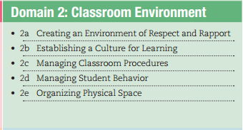
Danielson:
Notes:
Steve

Slide 12
Research Shows…
“Although research attests that students are most likely to be engaged in learning when they are active and given some choice and control over the learning process—and when the curriculum is individualized, authentic, and related to students' interests—surveys of classroom practices reveal that instruction emphasizing student passivity, rote learning, and routine is the rule rather than the exception” (Goodlad, 1984; Yair, 2000) - Motivating Students to Learn-Heather Voke - 2002
Notes:
Jessie

Slide 13
AND...
Children will be more likely to engage in learning when schools offer an environment that allows these needs to be met (Brooks, 1999). Educators must be attentive not only to teaching methods and the formal curriculum but also to the larger context of the school culture and disciplinary procedures; grouping practices; relationships between students, teachers, administrators, and parents; the physical structure of the school; and assessment strategies (Stipek, 1996; Yair, 2000). - Motivating Students to Learn-Heather Voke - 2002
Notes:
Jessie

Slide 14
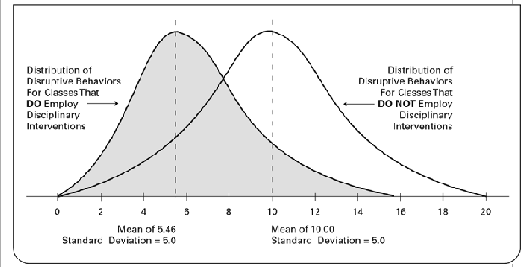
Marzano:
Notes:
Steve

Slide 15
Marzano:
Notes:
Steve

Slide 16
BUT… There are Barriers...
Educating for student engagement also requires a great deal from teachers; they must have a solid understanding of multiple subject areas and sophisticated pedagogical skills to ensure that the curriculum engages students and covers the knowledge and skills that all students should learn.
Motivating Students to Learn-Heather Voke - 2002
Notes:
Jessie

Slide 17
AND...
Teachers, too, may be uncomfortable modifying long-standing habits of instruction, believing that the safety of the tried-and-true method outweighs the risks associated with innovation.
Notes:
Jessie

Slide 18
So…
How do we coach or encourage teachers take risks?
Notes:
turn and talk - Jessie

Slide 19
Modeling Procedure Strategies
We are going to divide you into three groups.
Group 1 will go with Jessie Karches and Group 2 will go with Elizabeth Freas/Steve Graser.
You will move at the signal provided.

Slide 21
Station #1 - Managing Problem Behaviors
Brainstorm a list of behavior problems you see or have experienced
Chart behavior problems and possible solutions in the Google Doc

Slide 22
Station 2
Transitions In the Classroom
Groups of 4 -- Number off 1- 4
1 = Intro - Planning for Transitions
2 = Planning for Transitions - Pre-Corrections
3 = Pre-Corrections - Active Supervision
4 = Active Supervision - End (Final Thoughts)
JIGSAW

Slide 23
= I know this!
= This is important to me!
?
=Would like more info about this!
Focused Reading
Notes:
Suggested Language: “Paraphrasing is brain-compatible. The paraphrase sends a message I am not attacking you. Allows blood flow to neo-cortex instead of to brain stem and limbic system. Peptides located throughout body carry messages in blood stream, positively affects body chemistry.”
Strategy: Focused Reading
OR
Strategy: Partners Paraphrase
Designate an A and B.
Beginning on page 47 in the LG, Paraphrasing, read the first paragraph, silently simultaneously.
After reading, A will paraphrase.
Read the next paragraph and B will paraphrase.
Continue pattern until the end of the page

Slide 24
Station 2
At signal, join an expert partner from another table, and:
Clarify your understanding
Generate connections to your school
Prepare to teach your group

Slide 25
Take a Break!

Slide 26
Addressing Behaviors in the Classroom

Slide 27
Setting Limits
Notes:
Begin DVD at 5:56 and end at 10:00. Continue DVD at 12:15. Have you ever responded to someone based on emotion or have someone responding to you based on emotion? How important is body language when dealing with situations?

Slide 28
Setting Limits
Setting a limit is not the same as giving an ultimatum.
“When you hang up your coat. I’ll know you’re ready to work. If you keep your coat on, you’re still on a break.”
Limits are to teach, not punish.
“Remember yesterday. If you stop cursing and yelling. I may be able to help you. If you keep cursing and yelling, I won’t be able to help resolve this.”
Limits are more about listening than talking.
“Limits may be different for all students. By listening, you will learn what is important and set more effective limits.”

Slide 29
Setting Limits
1. Explain which behavior is inappropriate “Insults and name calling are not allowed. I just hear both.”
2. Explain why the behavior is inappropriate. “Throwing objects may hurt other students.”
3. Give reasonable choices with enforceable consequences. “If you place the chair under the table, we will continue. If you break furniture, I have to inform the principal.”
4. Allow time. “Think about your choices. I will check back in a few minutes.”
5. Be prepared to enforce. “As I promised, I have just called the principal.”

Slide 30
Avoiding Personal Power Struggles: Myths vs. Realities
Myth
1.I can make individuals choose appropriate behavior.
2.By setting limits, I take the position as the enforcer of punishment.
3.I am responsible for an individual’s behavior.
Reality
1.No one can make individuals do anything they do not choose to do.
2.By setting limits, you are offering choices. The individual ultimately chooses the consequence.
3.You are responsible only for providing a structure that outlines choices and consequences that are available to the individual.
Notes:
Table sheet

Slide 31
Avoiding Personal Power Struggles: Myths vs. Realities
Myth
4.When setting a limit, I must strictly adhere to that limit and not deviate from it.
5.People who successfully set limits get individuals to listen to them.
6.If I don’t gain compliance, I have failed.
Reality
4.You need to be willing to be flexible if you want to limit setting to be successful.
5.People who successfully set limits listen carefully and actively to individuals.
6.Setting limits appropriately increases your chance of compliance, but does not guarantee compliance. If someone chooses not to comply by enforcing your consequences, you have provided a structure for future learning.

Slide 32
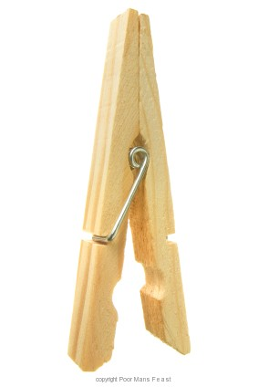
PROACTIVE CLASSROOM MANAGEMENT TACTICS
5 to 1 ratio of positive to negative interactions
Positive interactions consist of words, gestures (thumbs up), or physical contact (pat on the shoulder, high five) that have a positive quality to them and are delivered contingent on desirable behavior
Helps students learn expected behaviors and teachers build stronger relationships with students
Reprimands or corrective statements work better in the context of a positive, reinforcing environment

Slide 33
Danielson Special Education Scenarios
Danielson Scenarios Website
Danielson Scenario Document
Notes:
Use the 4 As protocol to look at Danielson’s scenarios on the 3rd Domain

Slide 34
Danielson Scenarios
Notes:
Steve

Slide 35
Organize and Integrate
- on a Post It Note
3 things that you learned…
2 Questions you still have…
1 thing that you would like the instructor to know...

Slide 36
BEHAVIOR PROBLEMS POSSIBLE SOLUTIONS
A child constantly blurts or interrupts | Partner share – have them tell answers to children at their tables before sharing with you Dry erase board – this way they can flash you the answer rather than blurt it out A tally sheet – They mark down when they blurt out to create awareness of problem, no punishment attached
The child that cannot sit still | Give them a movement break – a quick walk around the school usually helps Allow them to work where they choose, at least then they will not distract their seat mates
A child is off task | Provide Positive feedback when Child is on task Provide Attention Breaks Select Activites that require active responses
Notes:
behavior problems chart paper generate ideas, lap tops with google docs to populate chart of behavior problems and possible solutions

Slide 37
BEHAVIOR PROBLEMS POSSIBLE SOLUTIONS
A child that distracts others | Provide positive praise towards others. Provide positive instructions when moving to another task. Individualized behavior contact explaining the positive results wanted.
A child refuses to complete a task | Talk with student individually about the issue. Break tasks into smaller chunks. Provide alternatives to completing the work. Must still complete task but not all at one time.
Sleeping in Class | Discuss with student outside of class. Actively engage the class to keep student interested. Fitness and Energy breaks.

