Slide 1
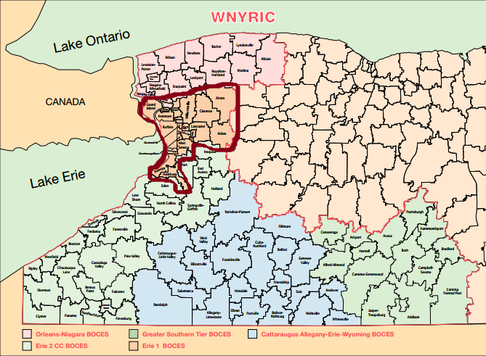
Administrative Leadership Service
NYSED Requirements Outlined in 30-2.9(b)
All evaluators must be appropriately trained, but only lead evaluators need to be certified to conduct evaluations. Districts will be required to provide appropriate training and certify their lead evaluators. State developed evaluator training will be provided to Network Teams (for teacher evaluation). The Erie 1 BOCES Network team will be able to “turn-key” the training to participating school districts. Districts may choose to take advantage of this training program or they may develop or contract for their own training and evaluator certification programs.
Website: http://e1badmin.weebly.com/
Mission Erie 1 BOCES commits to those we serve students, staff and communities by understanding, anticipating and responding to their needs.

Slide 2
Year 1 – 3: Compliance
Focus:
APPR Guidance and Regulation: Distribution of information
Inter-Rater Reliability (Videos)
SLO development
Teacher Standards and Evaluation
Resources: SED and NTI

Slide 3
Year 1 2012 - 2013
Promising Practices in Principal Evaluation
The Role of Data in RttT
Inter Rater Reliability: Teacher Evaluation
New Administrator Training
Lessons Learned from SLOs
Bridging the CCLS and Evaluation

Slide 4
Year 2 2013 - 2014
APPR Updates and Inter-Rater Reliability
Experiencing the Tri-State Rubric, Evidence Collection Tool & Shifts in ELA
Inter Rater Reliability: Teacher Evaluation
Data Driven Instruction
Analyzing & Improving the SLO Process
SWDs and ELLS
Metrics & Instructional Implications
New Administrator Training

Slide 5
Year 3 2014 - 2015
APPR Evaluator Workshop
Data Analysis and Inter Rater Reliability with ELLs
Data Analysis and APPR
New Administrator Training
Special Expo: Stem for Evaluators
NYSED Accountability Data and Inter Rater Reliability in the Co-Taught Classroom

Slide 6
Evaluating Best Practice and Research
Focus:
Educational Research and Best practice in classrooms
providing Growth producing and Evidence based feedback around best practice and instruction.
Presentations included E1B District initiatives modeling engagement strategies (Kagan, Adaptive Schools, Differentiated Instruction, Collaborative Teaching, EDI)
Resources: Educational Research, Field Texts and Structures, and SED

Slide 7
Year 4 2015 - 2016
Brad Geise's presentation
Questioning and Discussion
Student Engagement
Blueprint for Special Education and Multiple Pathways
Managing Classrooms
New Administrator Training
Communicating with Students

Slide 8
Why?
Influence | Effect Size | Source of Influence
Feedback | 1.13 | Teacher
Instructional quality | 1.00 | Teacher
Direct instruction | .82 | Teacher
Remediation/feedback | .65 | Teacher
Student's disposition to learn | .61 | Student
Class environment | .56 | Teacher
Challenge of Goals | .52 | Teacher
Questioning | .41 | Teacher

Slide 9
The Series
Student Engagement : Neural Fatigue, Interrelated Neural Systems, (Danielson 3C)
Managing Classrooms : Disruptions, behavior management, setting limits, (Danielson 2 and 3A)
Communicating with Students : Expectations, directions, written/oral language, (Danielson 3A)
Questioning and Discussion : Level of questions, wait time, discussion, (Danielson 3B)
Special Education and Pathways: Blueprint, Multiple Pathways (Danielson 1 b-d, 4b,c)

Slide 10
Collaborative Feedback
Notes:
The timer is set for 3 minutes and each person in each group writes their own definition of engagement on an index card. - Jessie
2.When everyone has completed their definition, they pass their card clockwise to the next person in their group.
3.The person who receives the index card underlines what they feel are the most important words in the definition.
4.The cards are progressively passed, and words underlined until they reach the original writer.
5.Then, the group uses the underlined words to create a unified definition of UDL.
6.Finally, each group presents their definition to the large group.

Slide 11
Question:
Based on your knowledge of Athenian Democracy would implementing a direct democracy in our local government improve our quality of life?

Slide 12
Provide Feedback around the scenario/question on the table- you may suggest an alternative
Pass card clockwise
Underline or highlight the words
that are most important to you
Pass clockwise and repeat with next
card until returned to author
Using the underlined words create a new question based on the feedback that your table provided and write it on the index card on your table
Notes:
The timer is set for 3 minutes and each person in each group writes their own definition of engagement on an index card. - Jessie
2.When everyone has completed their definition, they pass their card clockwise to the next person in their group.
3.The person who receives the index card underlines what they feel are the most important words in the definition.
4.The cards are progressively passed, and words underlined until they reach the original writer.
5.Then, the group uses the underlined words to create a unified definition of UDL.
6.Finally, each group presents their definition to the large group.

Slide 13
http://e1badmin.weebly.com/

