Slide 1
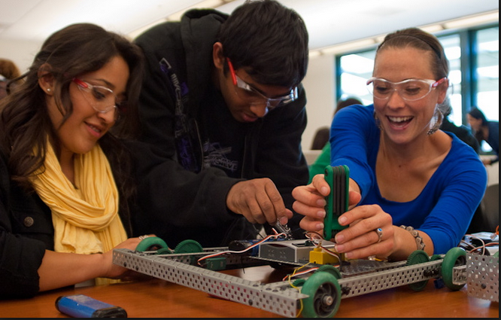
Add STEaM to your Curriculum, An Overview of How it Connects.

Slide 2
Agenda
Adding STEaM:
Setting a definition
Teaching Pedagogy, Methods for approaching STEaM
The Challenge
How Does it Connect:
Jot Thoughts- Standards connection
How do we begin?
Debrief

Slide 3
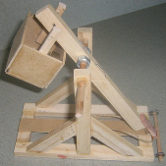
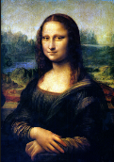
Add STEaM…Don’t get hung up on the acronym…
But, the Acronym Means:
Science
Technology
Engineering
arts
Mathmatics

Slide 4
Add STEaM… Create a Working Definition
Take 2 minutes and record your current definition of STEAM.

Slide 5
Add STEaM…
We have spent the time learning the College and Career ready skills, now is the time to talk about the “vehicle” for getting there!
STEaM is an integrated approach of teaching that leads to deeper learning and acquisition of 21st Century skills by students.
Notes:
Give STEAM acronym
Why to admins need time to collaborate? They need to know the goal to help create the community partnerships
Be honest with the barriers for STEAM, money/ materials, time, storage, pd

Slide 6
Add STEaM… Using a “New Vehicle”
Criteria | “Vehicle 1” Inquiry | “Vehicle 2” Project Based Learning (PBL)
Learner engages in scientifically oriented questions | ☑ | ☑
Learner gives evidence priority in responding to questions | ☑ | ☑
Learner formulates explanations from evidence | ☑ | ☑
Learner connects explanations to scientific knowledge | ☑ | ☑
Learner Communicates and justifies explanation | ☑ | ☑

Slide 7
Add STEaM… Using a “New Vehicle”
Criteria | “Vehicle 1” Inquiry | “Vehicle 2” Project Based Learning (PBL)
Hands-on learner directed activity | ☑ (sometimes) | ☑
Learners retain more knowledge | ☑ | ☑
Learners solve real world tasks |  | ☑
Learner creates product, model, or prototype for solution (engineering) |  | ☑
Learner demonstrates the results in a performance or public speaking venue. |  | ☑
Learner uses extended period of time (1-6 weeks) |  | ☑
Incorporates school and community connections or outside professionals |  | ☑

Slide 8
STEaM in Action… the Story
In 2006 Rapheaella Le Gouvello left Exmouth in Australia to cross the Indian Ocean on a sailboard, alone, unassisted with no stopovers. The voyage took 60 days, 60 nights and was 6557 Km in length.

Slide 9
STEaM in Action… the Story
Rapheaella Le Gouvello’s Challenge:
Build a craft that would hold all supplies necessary to make the journey
A place to sleep
Food to eat
Clothes
Technology to communicate
A HEAVY amount of equipment…

Slide 10
STEaM in Action… the Challenge
Question: What were the design considerations necessary to make this voyage possible?
Challenge: Create a vessel to hold a minimum of 25 pennies for a minimum of 10 seconds without sinking (failure).
Constraints: You may only use the materials provided to your team. You will have a time limit.
Results: ??
http://teachers.egfi-k12.org/watercraft/

Slide 11
STEaM, How Does it all Connect?
Debrief: “Jot Thoughts” – 3 minutes
Use the slips of paper on the table and brainstorm the standards or skills that were covered while doing this activity.
1 idea per piece of paper. Place the slips in the center of the table, in attempt to “cover the table” (no slips overlap)
Write, then announce, what you have written while placing on the table.
Notes:
Have them do this, then hand out the standards sheet for the lesson. Note out loud that everyone in the room may have more familiarity with certain standard sets than others and there are more than one right answer.

Slide 12
STEaM, How Does it all Connect?
Standards Accomplished with Penny Boats:
Common Core State Standards Anchor Standards for Language Arts
ISTE Standards for Students in Technology
Common Core State Standards- Mathematics
Next Generation Science Standards
New York State Science Standards:
CCSS Language Arts (Student Capabilities) vs. 21st Century Skills
Notes:
Participants could take the “jot thoughts” activity and place them on the chart for student capabilities vs. 21st century skills.

Slide 13
STEaM, How Do we Begin?
Build your personal knowledge:
Project Lead the Way

Slide 14
STEaM, How Do we Begin?
Join or build relationships with local STEM / STEAM Groups:

Slide 15
STEaM… How Do we Begin?
Begin with the end in mind….
“Your school can implement STEAM if you have a starting point and a long terms goal”
Phase Tool

Slide 16
STEaM… In Summary
“Reaffirming and strengthening America’s role as the world’s engine of scientific discovery and technological innovation is essential to meeting the challenges of this century, that’s why I am committed to making the improvement of STEM education over the next decade a national priority.”
~President Obama.

Slide 17
STEaM… In Summary
KUDOS!
The first cohort of 16 NYS P-TECH programs will open its doors to over 800 students in September 2014 and will provide integrated education and thousands of hours of relevant and aligned work experience to approximately 6,000 students over the course of the next six years including Lackawanna Central School District, Trocaire College & Catholic Health System

Slide 18
Add STEaM… In Summary
The Obama Administration has already taken bold action in the STEM education arena by directing that the $4.35 billion “Race to the Top” school grant program assure a competitive preference to states that commit to improving STEM education.
http://www.ed.gov/stem

Slide 19
STEaM… In Summary
Revisit your definition, what has changed? Revise as necessary.
What is promising about integrating STEaM in your building?
What is problematic about integrating STEaM in your building?

